Slide 1
Shoe Sizing and Fitting
Josh White, DPM, CPed
Medical Director / VP Wholesale

Slide 2

Evaluation / Shoe Selecting Visit
Define good fit
Ask patient size
Evaluate patient shoe fit
Measure foot length using OrthoFeet stick
Estimate foot width
Try on
Try on again
Customize

Slide 3
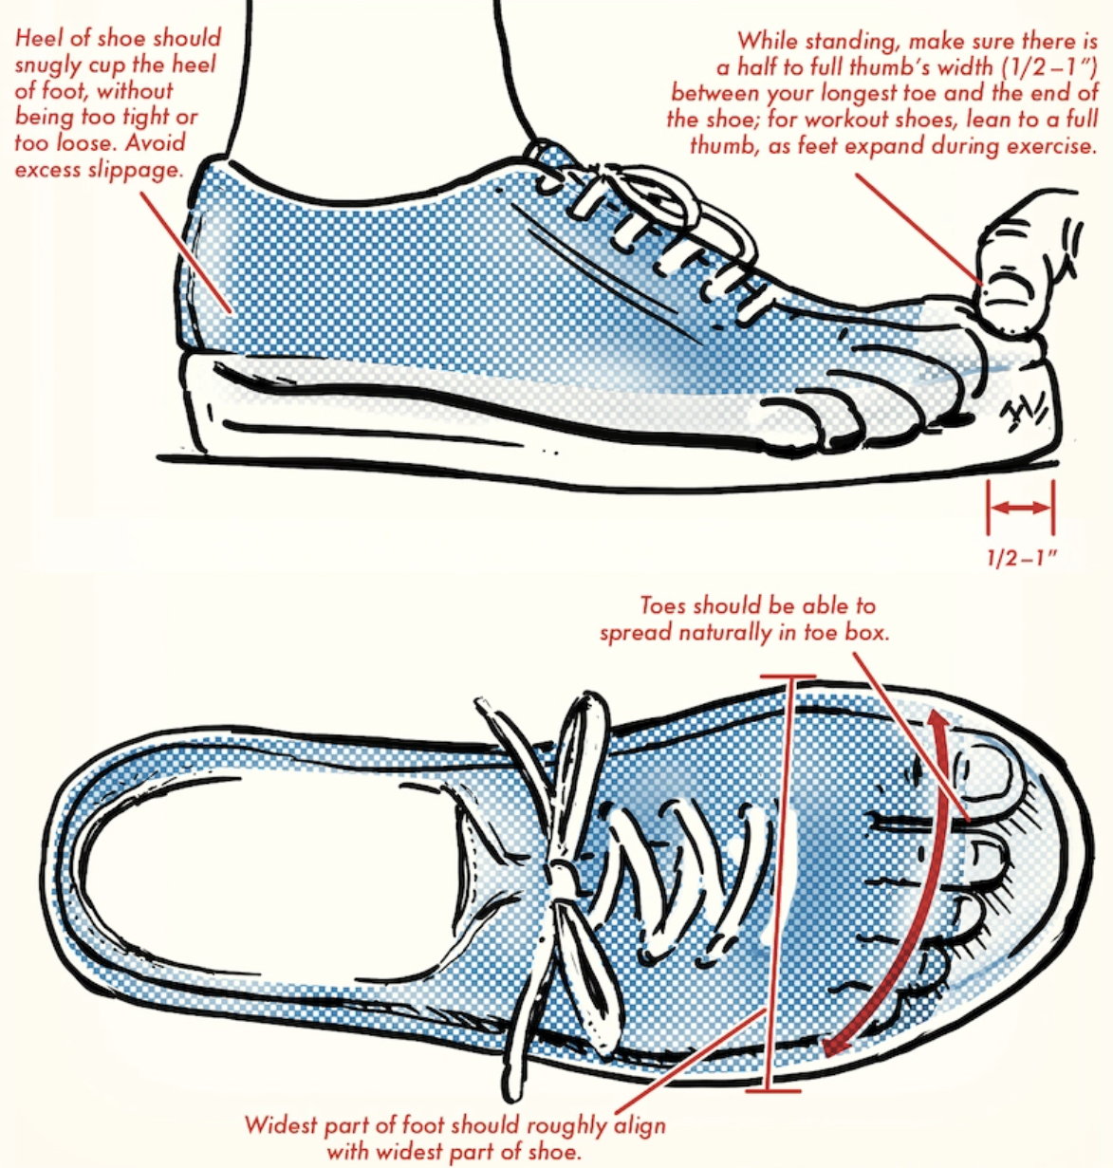
How to size OrthoFeet shoes:
Define good fit to patient

Slide 4
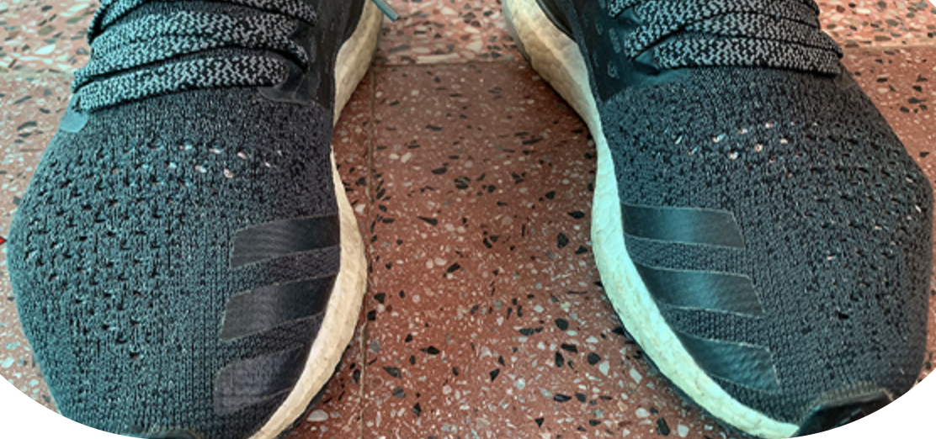
How to size OrthoFeet shoes:
Ask patient their shoe size

Slide 5
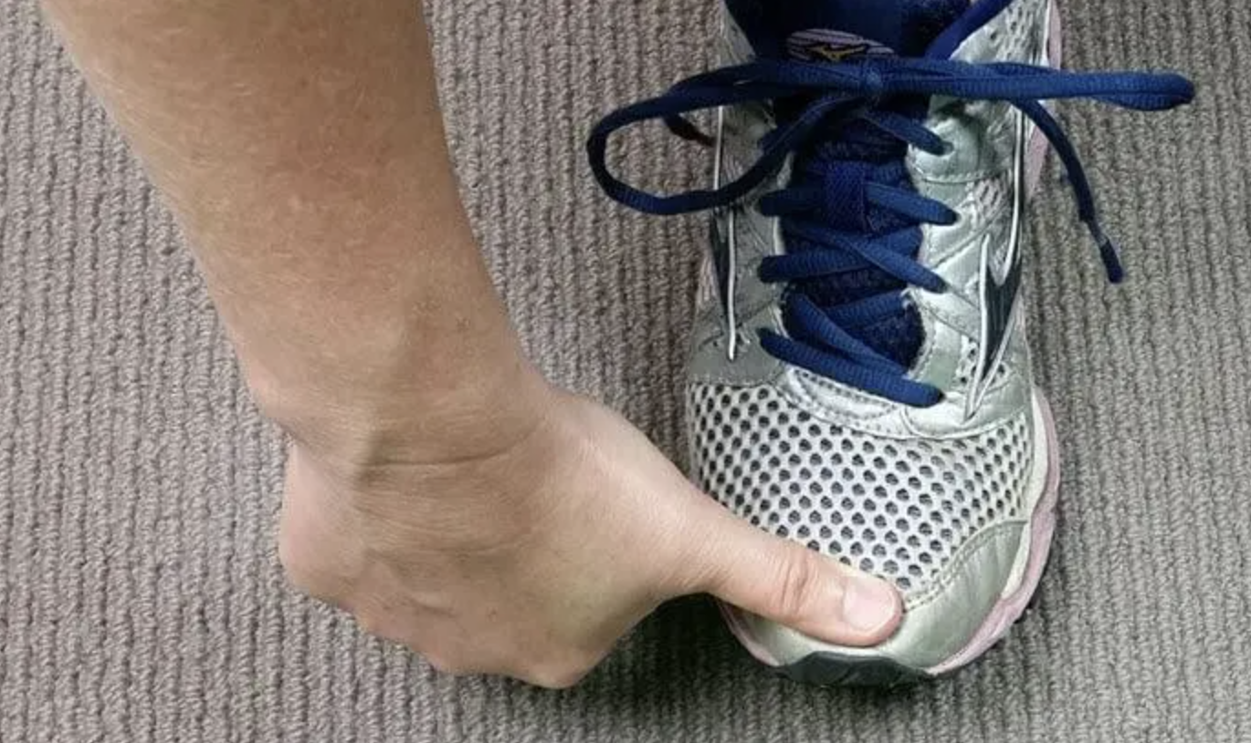
How to size OrthoFeet shoes:
Evaluate patient’s own shoe fit

Slide 6
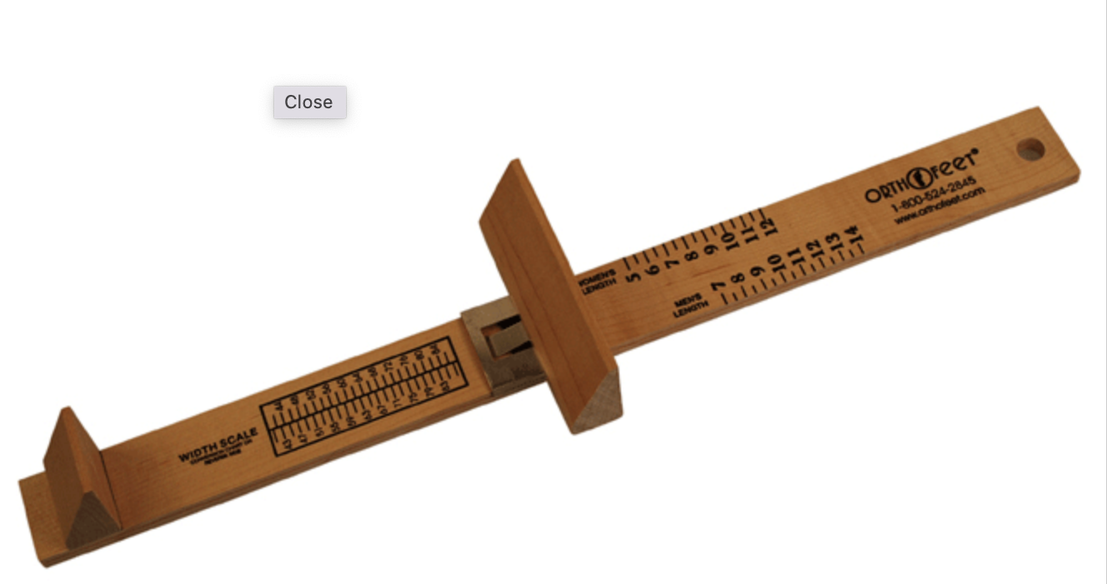
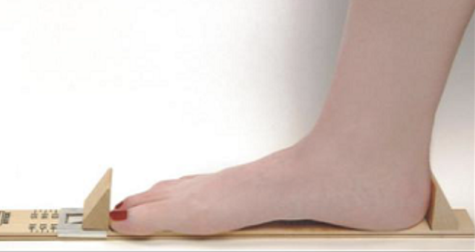
How to size OrthoFeet shoes:
Determine foot length using OrthoFeet measuring stick

Slide 7
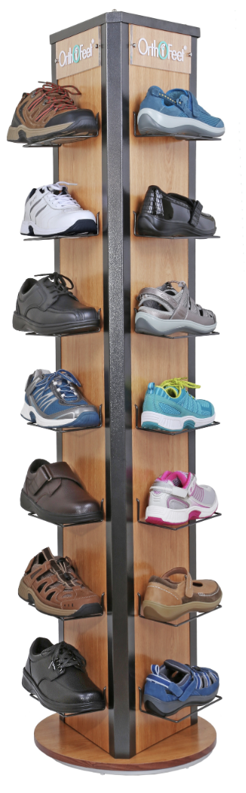
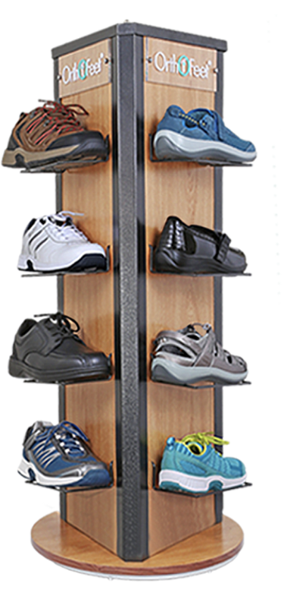
How to size OrthoFeet shoes
Display stands
Size run, wide width

Slide 8
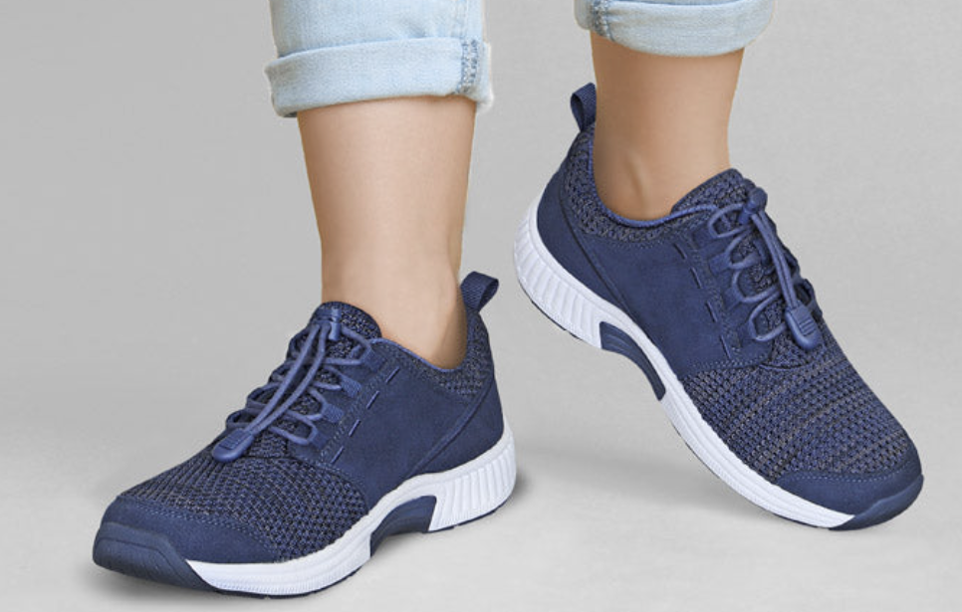
How to size OrthoFeet shoes:
Try on
Try on another size

Slide 9
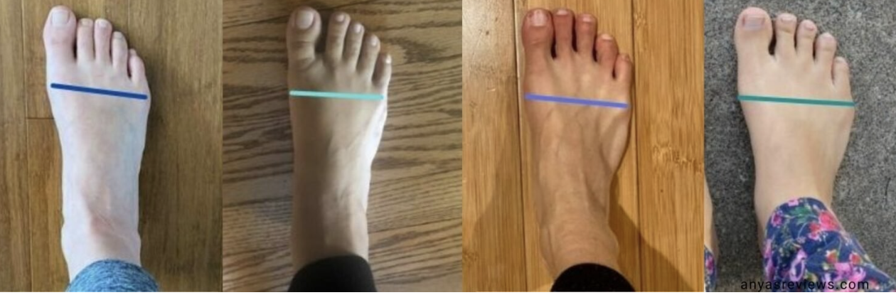

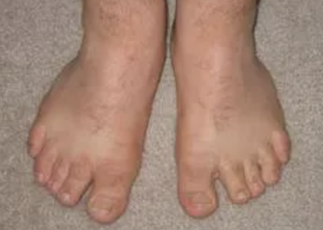
How to size OrthoFeet shoes:
Estimate foot width
Narrow
N
Medium
M
Wide
W
Extra Wide
XW
Extra Extra Wide
XXW

Slide 10
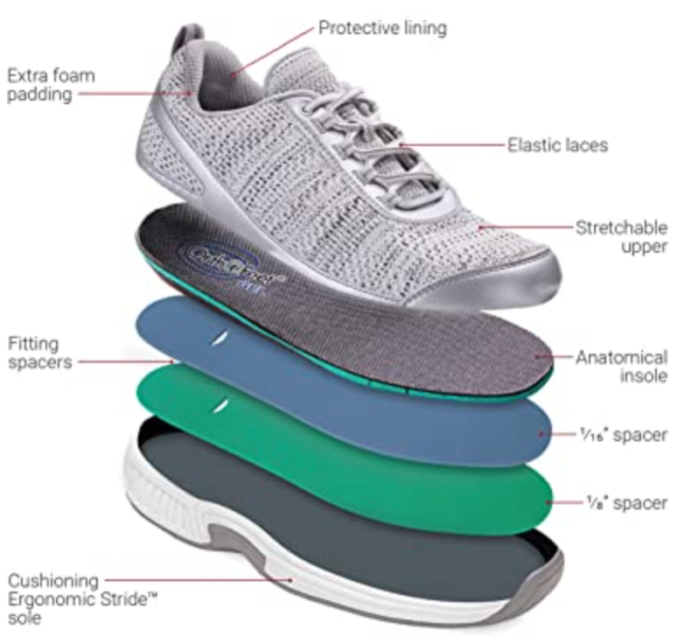
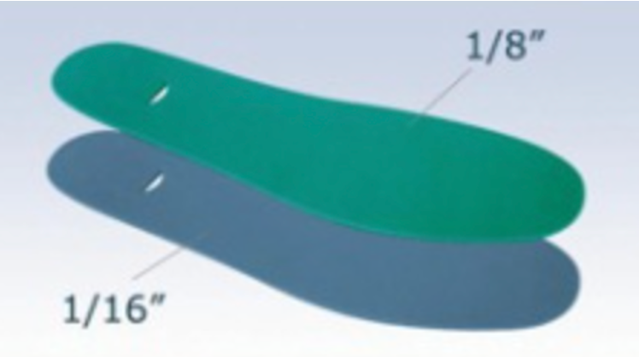
How to size OrthoFeet shoes:

Slide 11
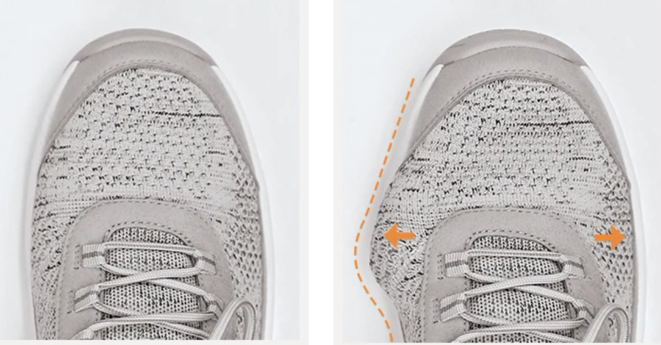
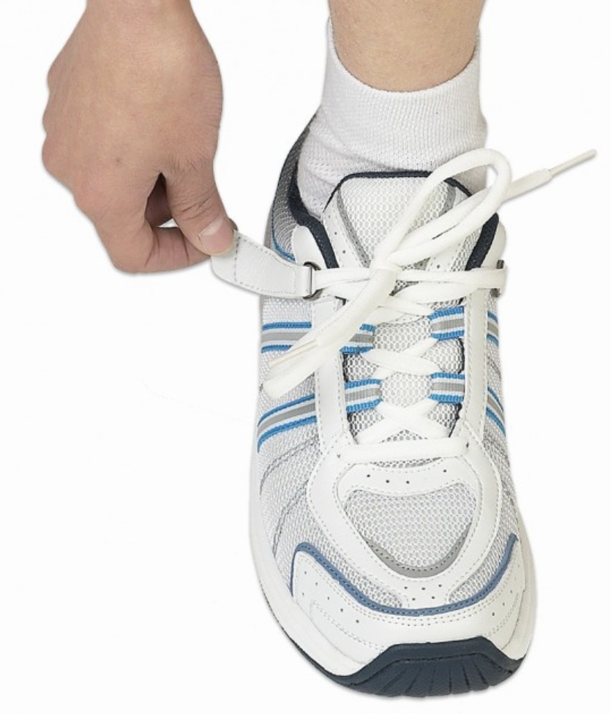
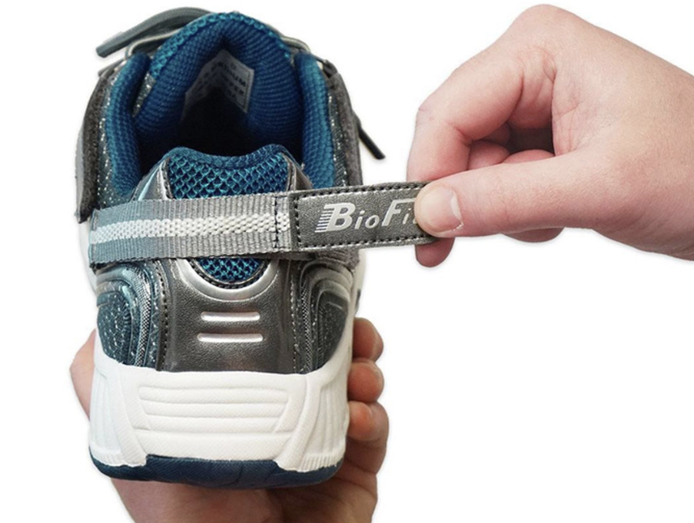
How to select shoe style:
Functionality

Slide 12
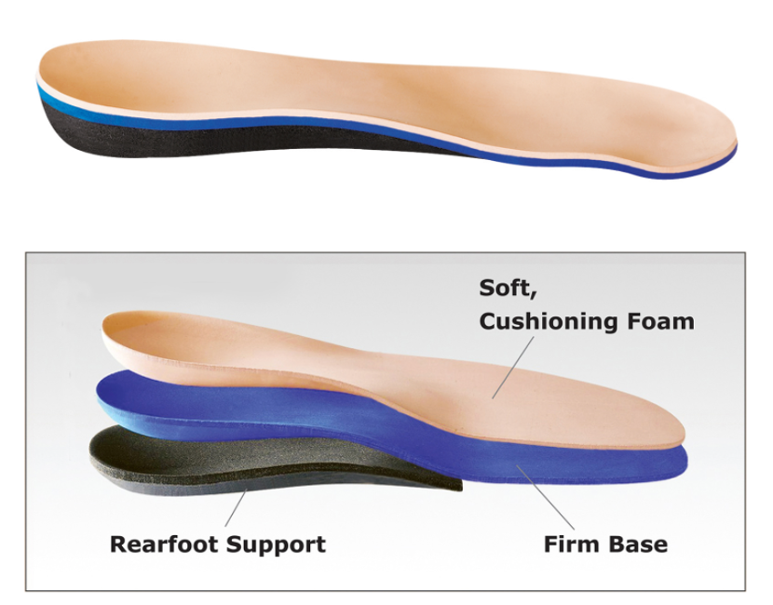
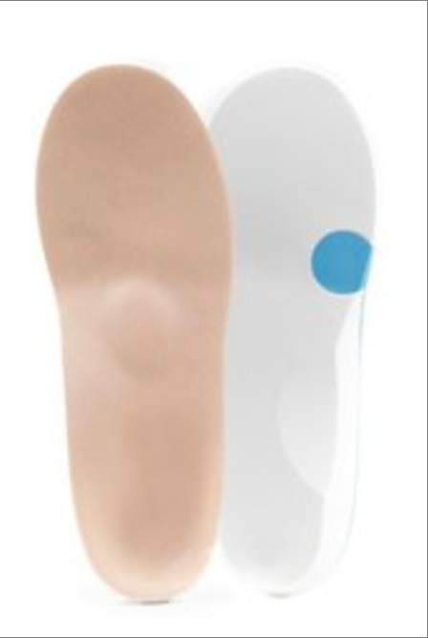
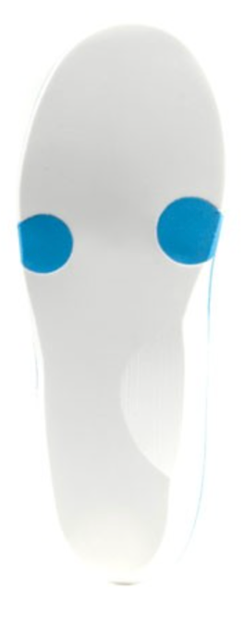
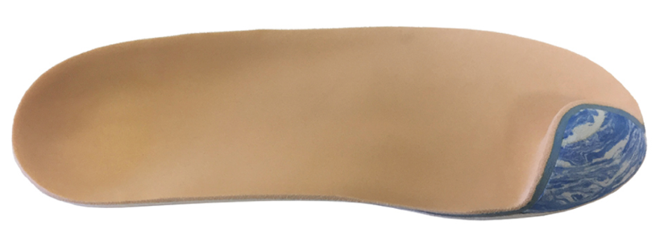
Insole Selection

Slide 13

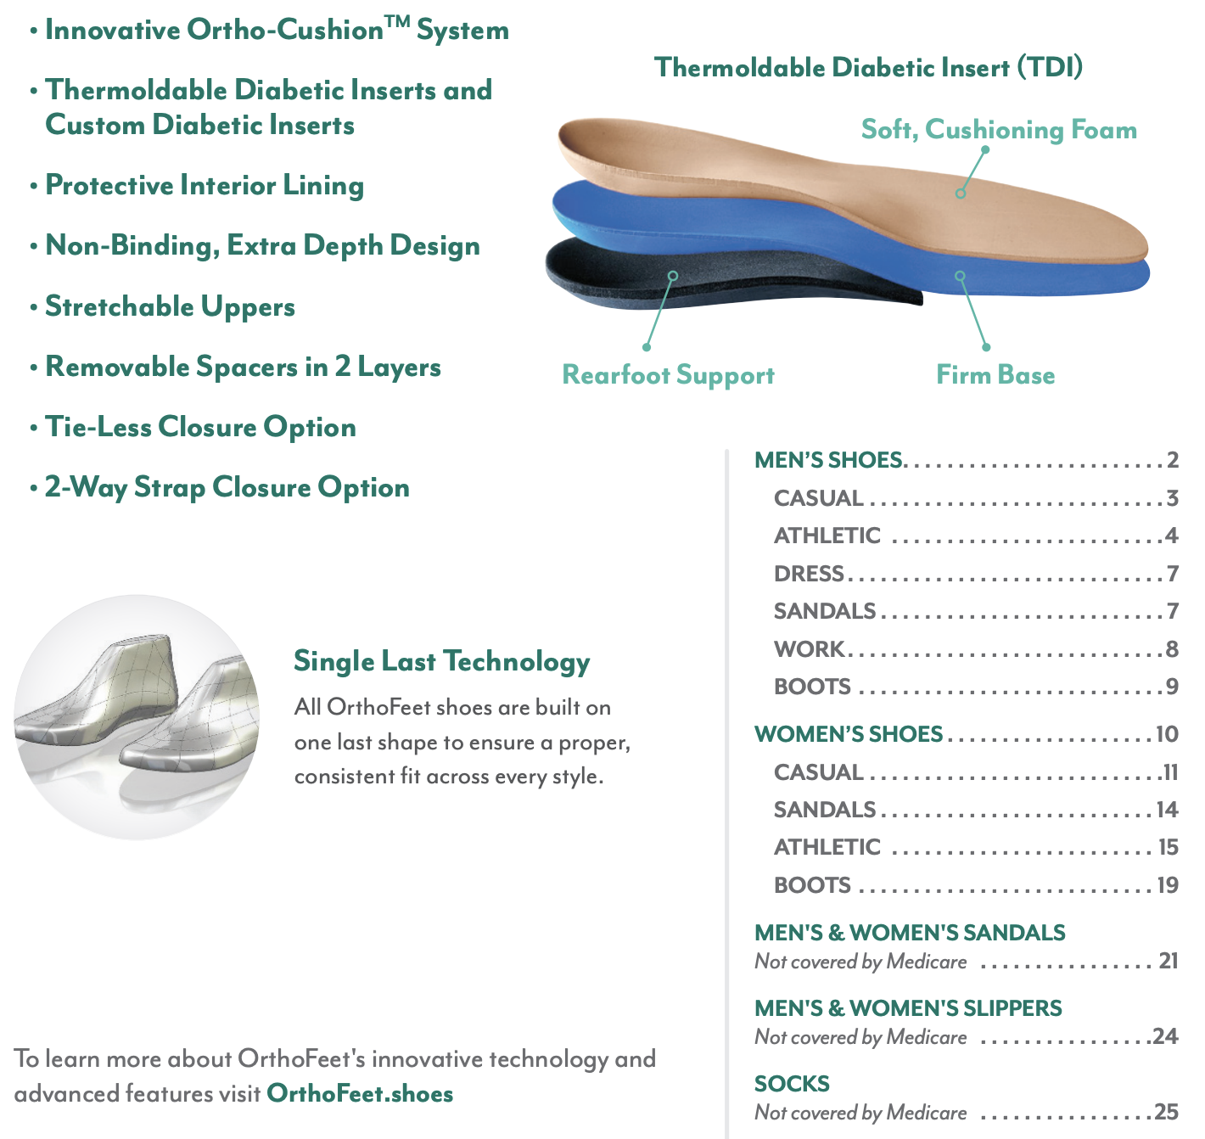
Review of Orthofeet Styles

Slide 14
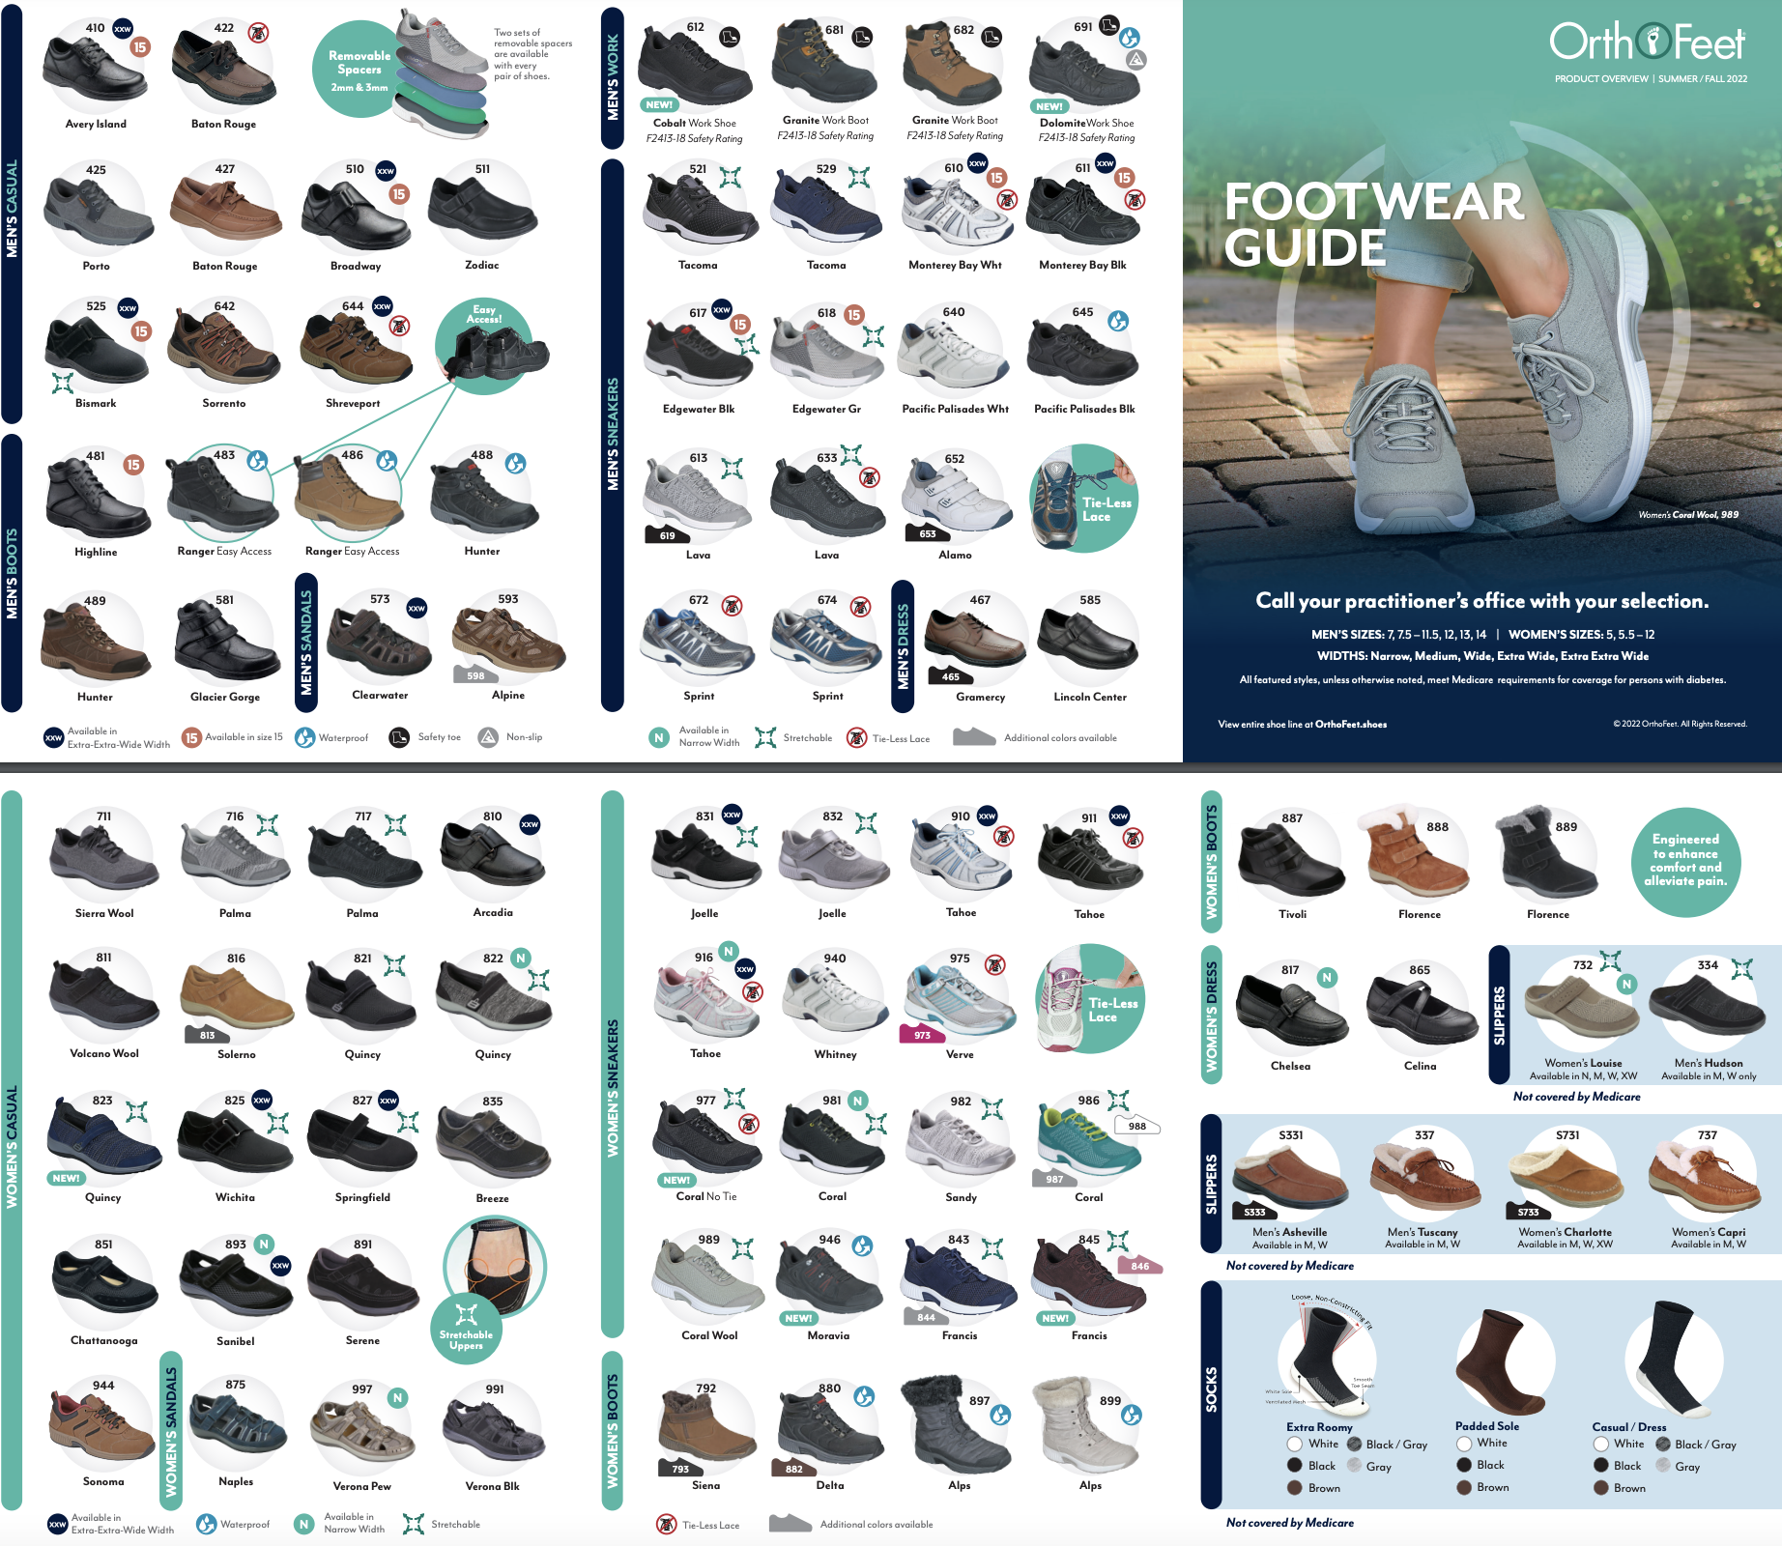

Slide 15
Shoe Dispensing
Set up shoes with single spacer and arch booster
Fit shoes with thickness sock typically worn
Have patient stand wearing shoes / inserts
Determine if ½ - ¾” space between end of longest toe and
end of shoe
Ensure shoes as wide as foot and that heel doesn’t slip
If loose, add additional spacer
If snug, remove spacer
Review break-in instructions.
If Medicare, have patient sign Delivery Receipt and provide
copy of Supplier Standards.

Slide 16

Thank you
Notes:
Thank you!

