Slide 1
DPM Ordering Shoes / Custom Inserts Using Ipad, Fusiform, SnugFit with Compliance Documentation
Josh White, DPM, CPed
Medical Director

Slide 2
Objectives
Gain a better understanding of the documentation requirements of the Medicare Therapeutic Shoe Program.
How to enter orders for shoes with prefab inserts using the “Procure EZ” program.

Slide 3

Let’s break it down
Medicare Compliance Documentation of DPM Shoe Supplier
From DPM / Supplier
fitting visit
Foot / Pre-fitting evaluation
Rx
From MD/DO
Foot evaluation / Co-sign
Certifying Statement
Relevant Medical Records
From
DPM / Supplier
Dispensing visit
Certificate of Receipt
Dispensing SOAP Notes

Slide 4
Step by Step How the process works:
Every patient with diabetes should be scheduled for annual diabetes foot risk assessment (pre fitting exam)
Evaluation documents specified Medicare requirements for shoes / inserts:
Neurological exam
Vascular exam
Dermatological exam

Slide 5
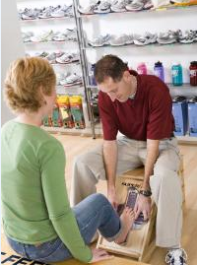
Pre-Fitting Exam
Patients having qualifying risk factors are fit for shoes and shoe selection made
If desire custom inserts, scan using iPad
Enter onto website, OrthoFeet.shoes

Slide 6
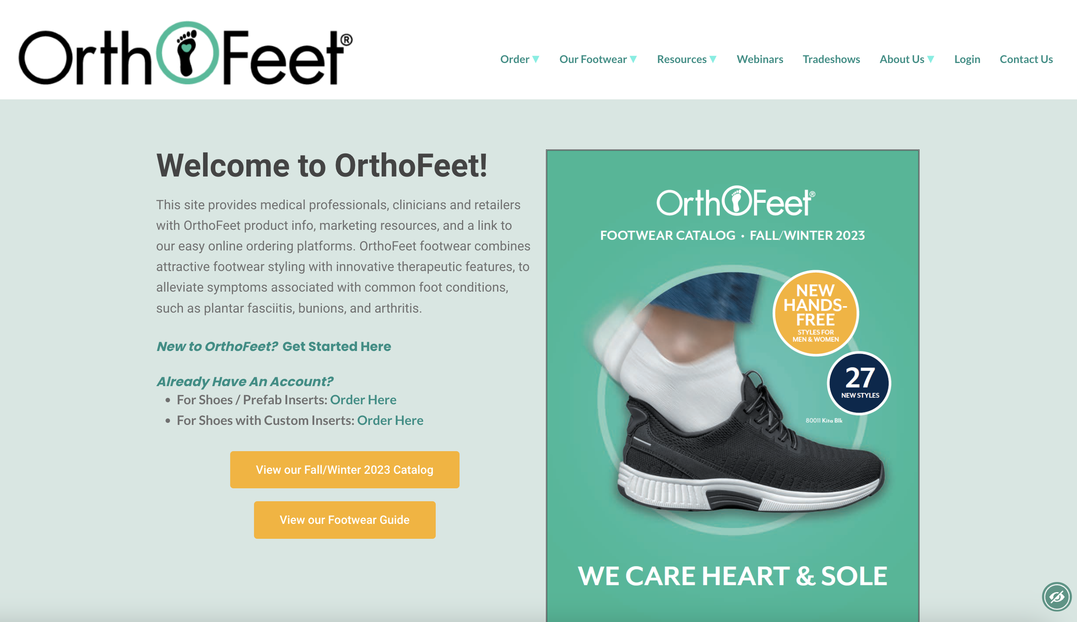
OrthoFeet.shoes “Compliance Check”

Slide 7
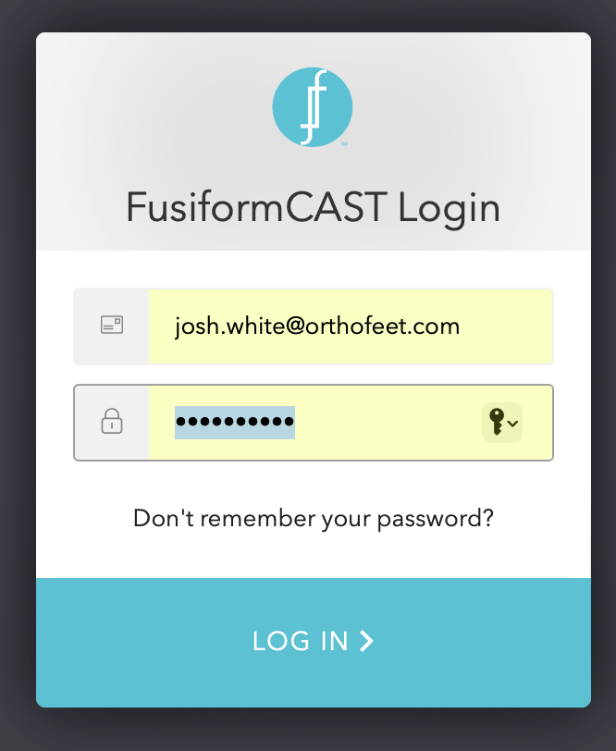
OrthoFeet.shoes “Compliance Check”

Slide 8
OrthoFeet.shoes “Compliance Check”
“Add patient”

Slide 9
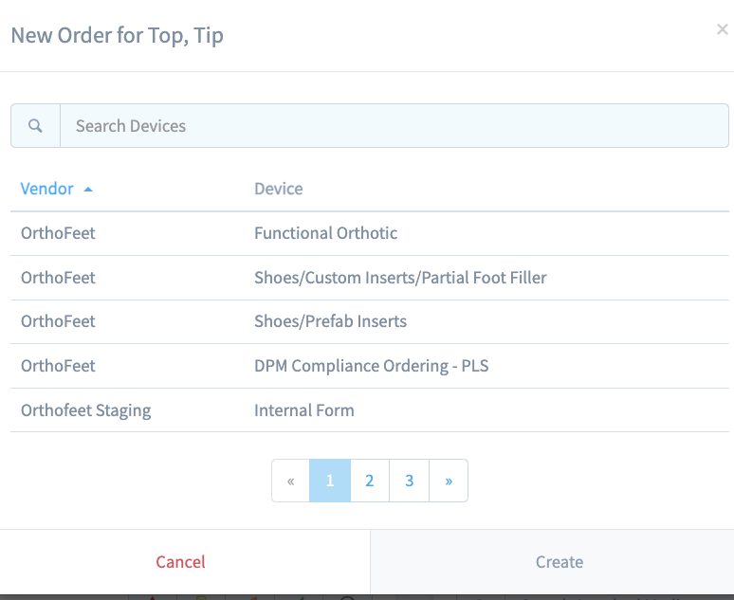
Form Type
“Add order”
“DPM Compliance Ordering” / “Create”

Slide 10
Form Type
“DPM Compliance Ordering - PLS”
“Open Order Form”

Slide 11
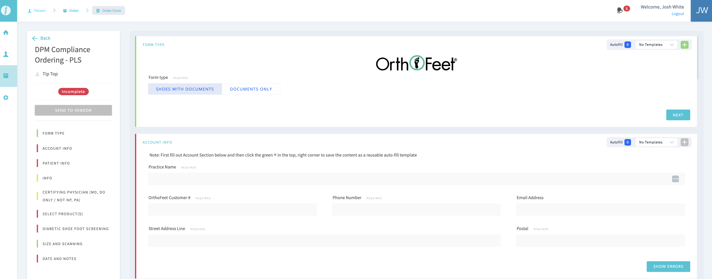
Form Type
“Form Type”
Shoes with Documents
Documents Only
“Next”

Slide 12
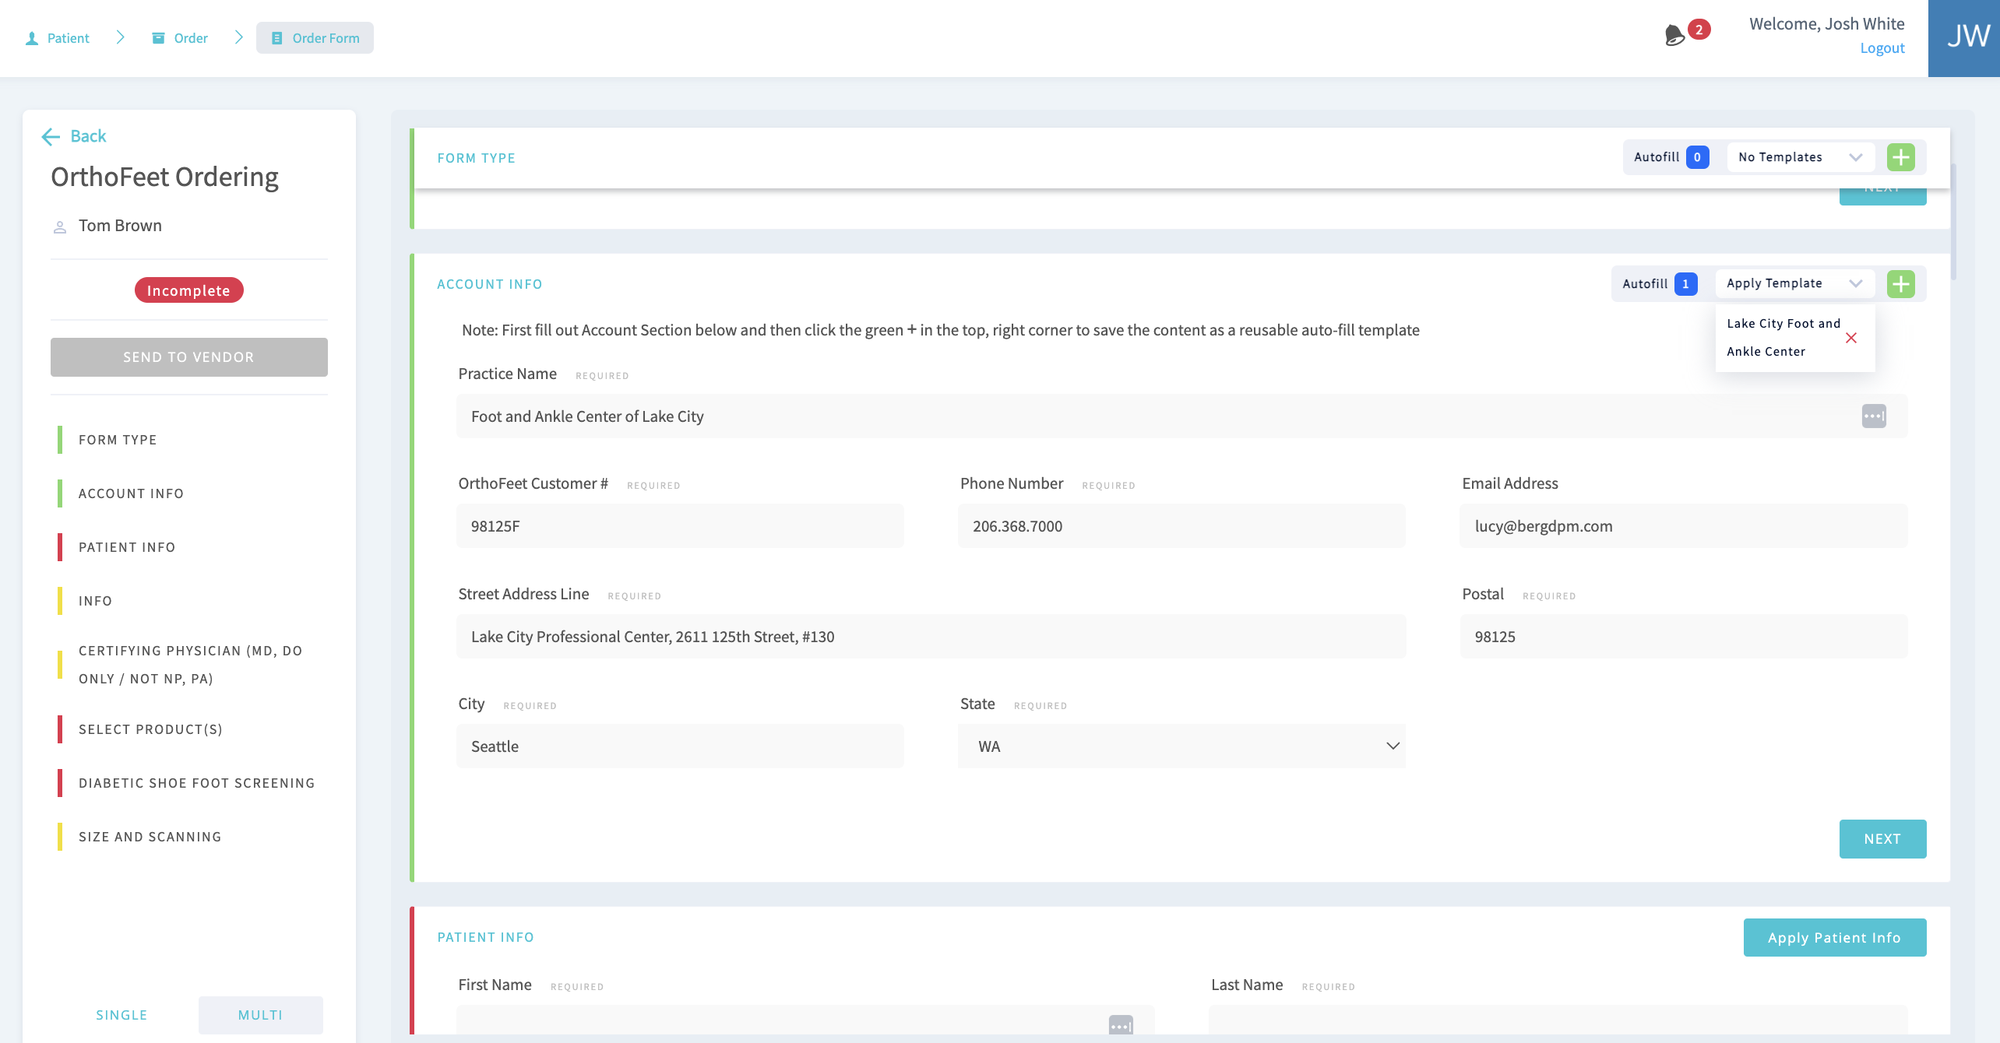
Account Info
“Account Info”

Slide 13
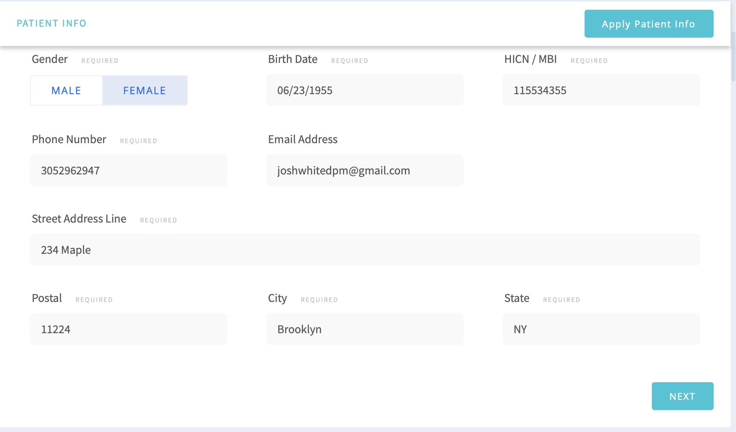
Patient Info
“Apply Patient Info”

Slide 14
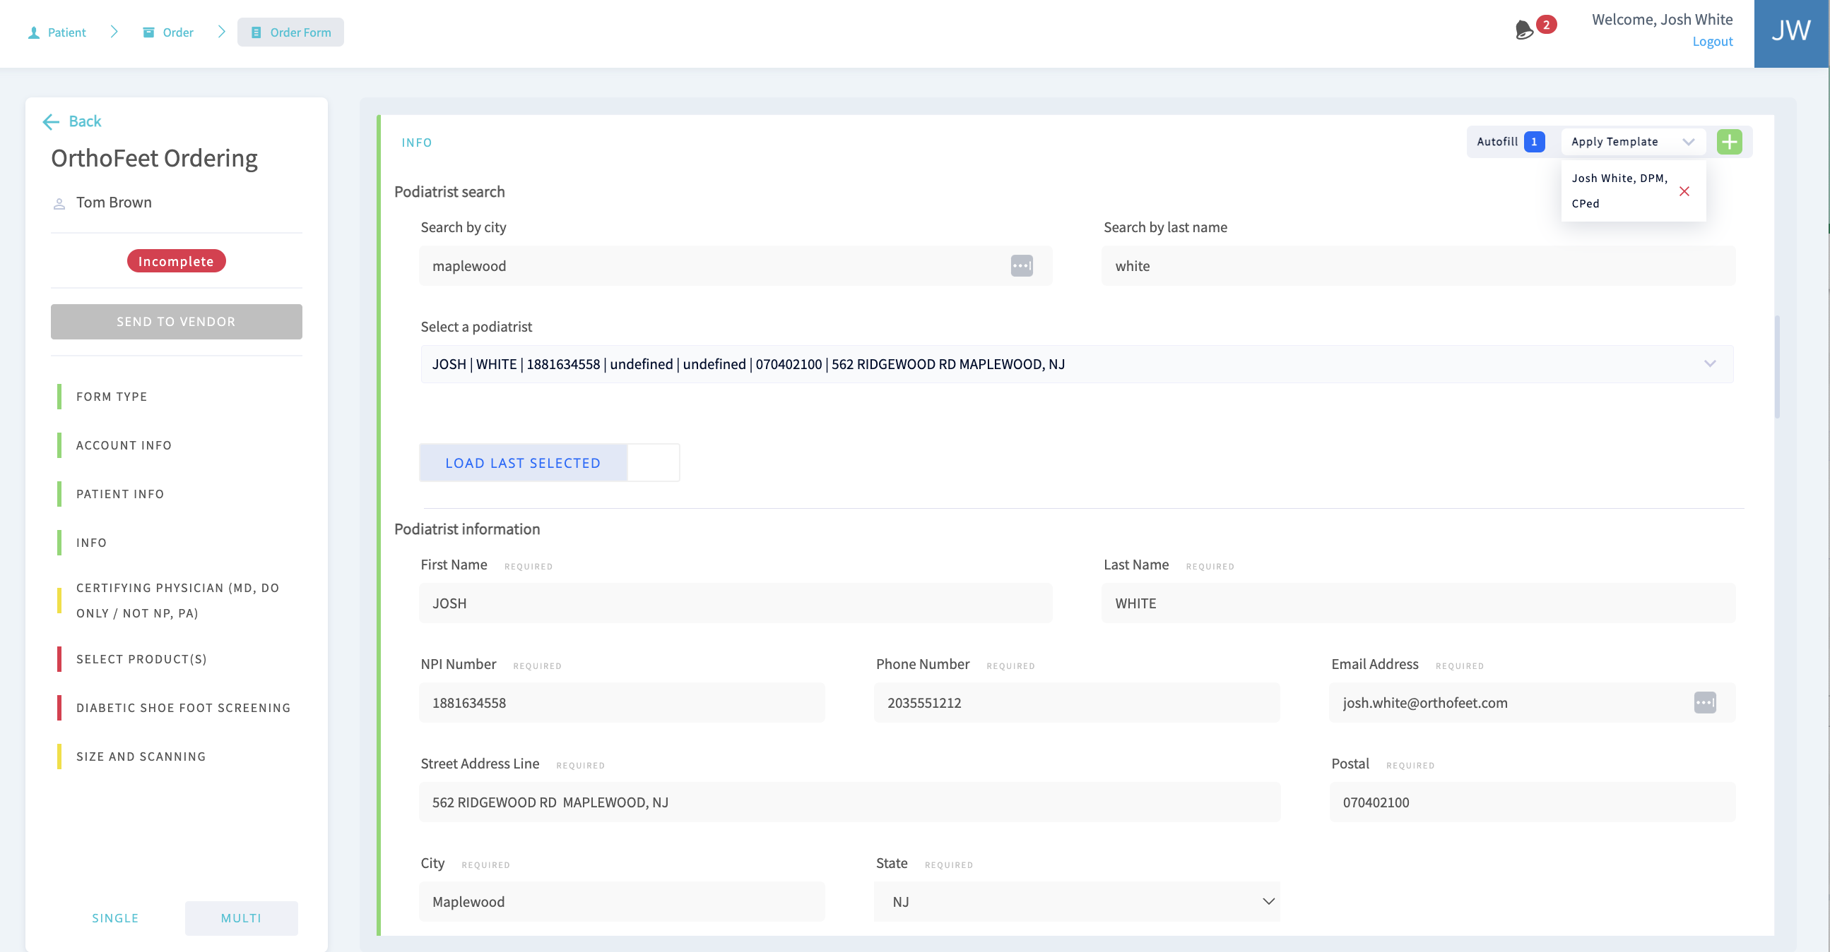
Podiatrist Info
Podiatrist Info
Set up templates
Auto search
“Load Last Selected”

Slide 15
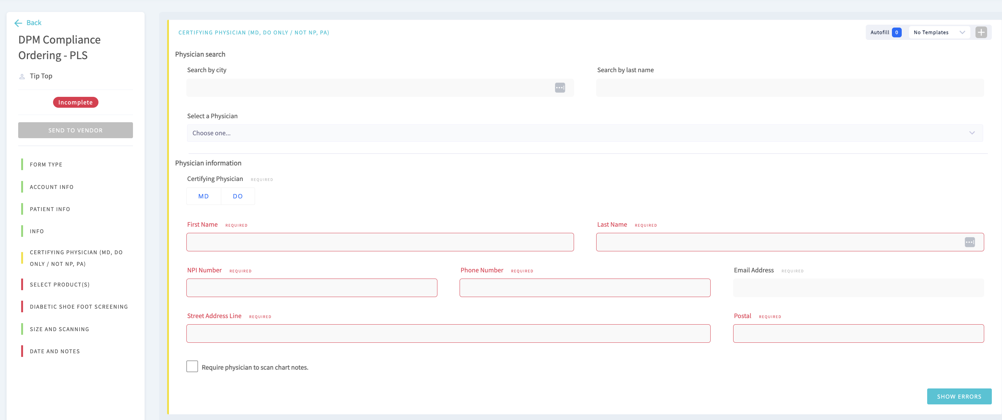
Certifying Physician Info
“Certifying Physician”
Certifying Physician Info
“Templates”
“Apply Physician Info”
Autofill City, State based on ZIP
Save as templates
Must be MD / DO; no NP, PA
“Require Physician to Scan Chart Notes”
If cannot get MD email, enter DPM email and send to self. Then fax to MD.

Slide 16
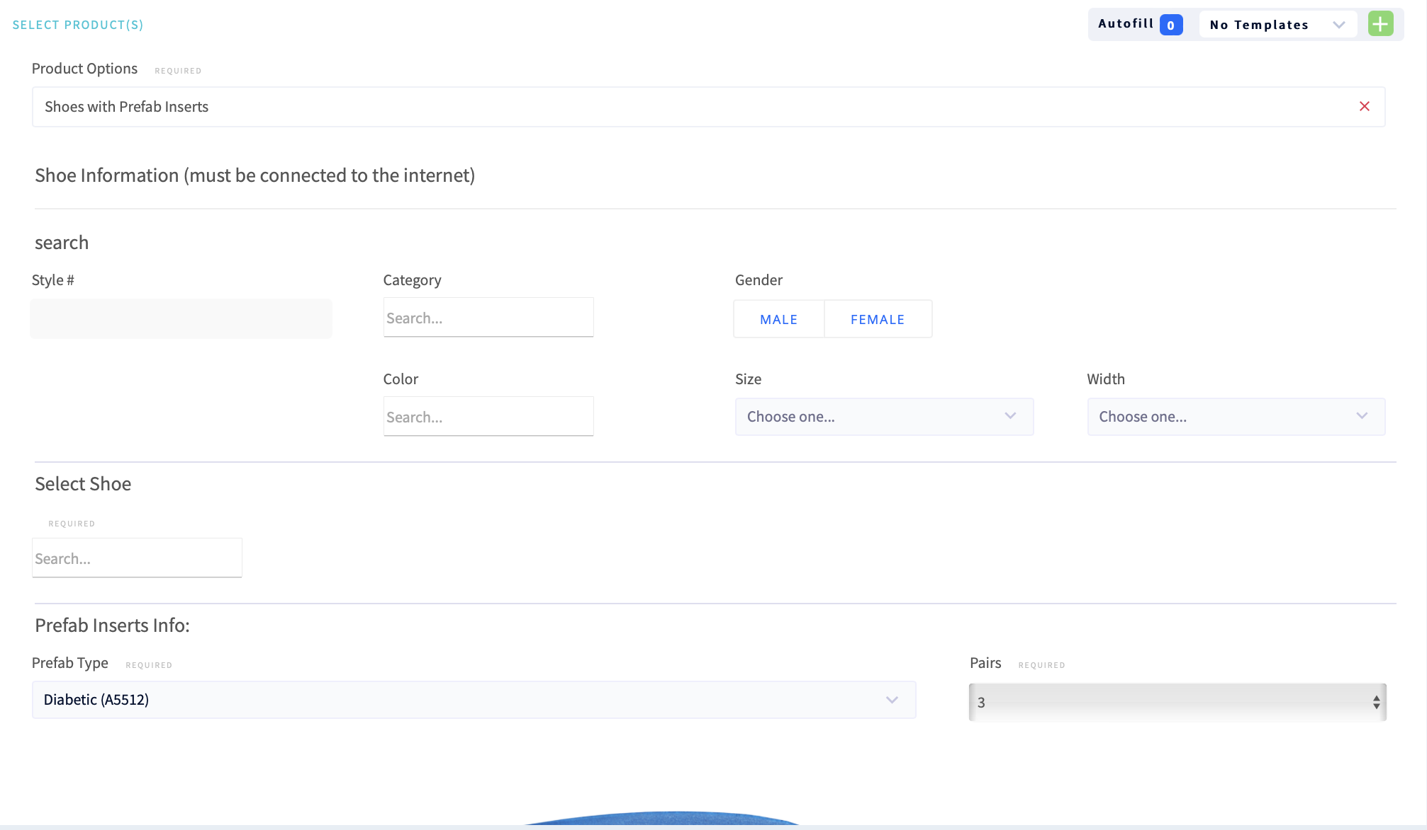
Select Products, Shoes with Prefabs
Product Options
Shoes with Prefab Inserts
Shoes with Custom Inserts
Shoes with partial foot filler
Patient Info

Slide 17
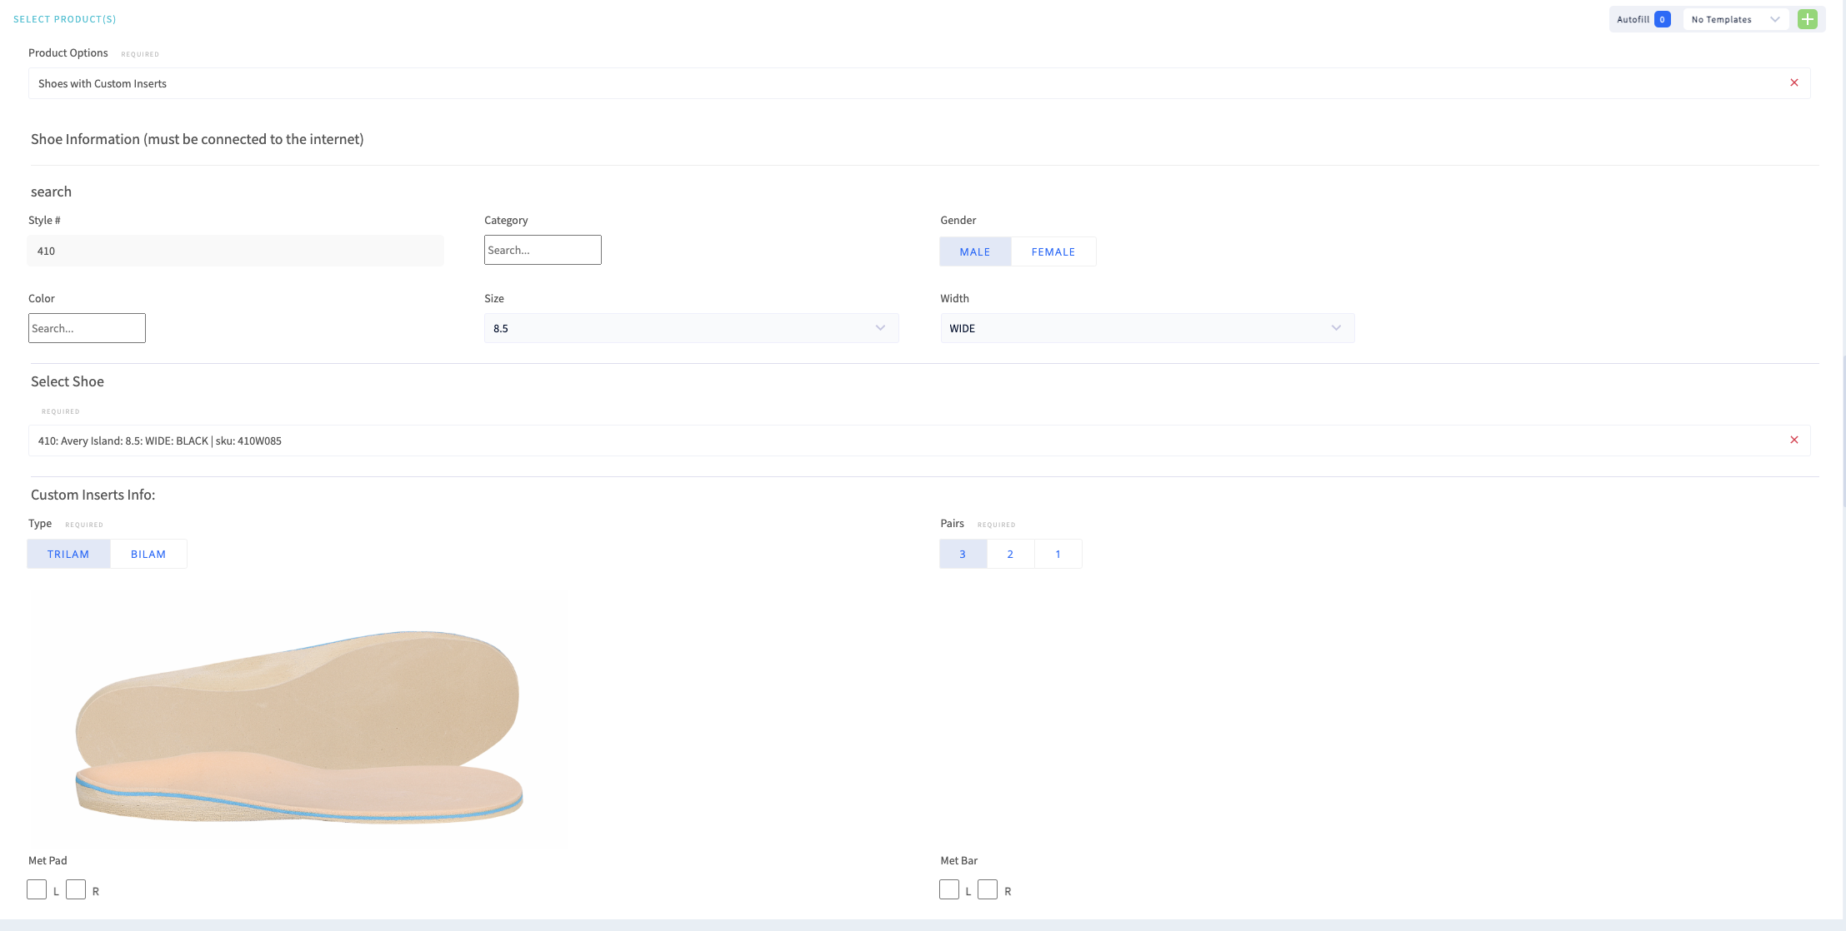
Select Products, Shoes with Custom

Slide 18
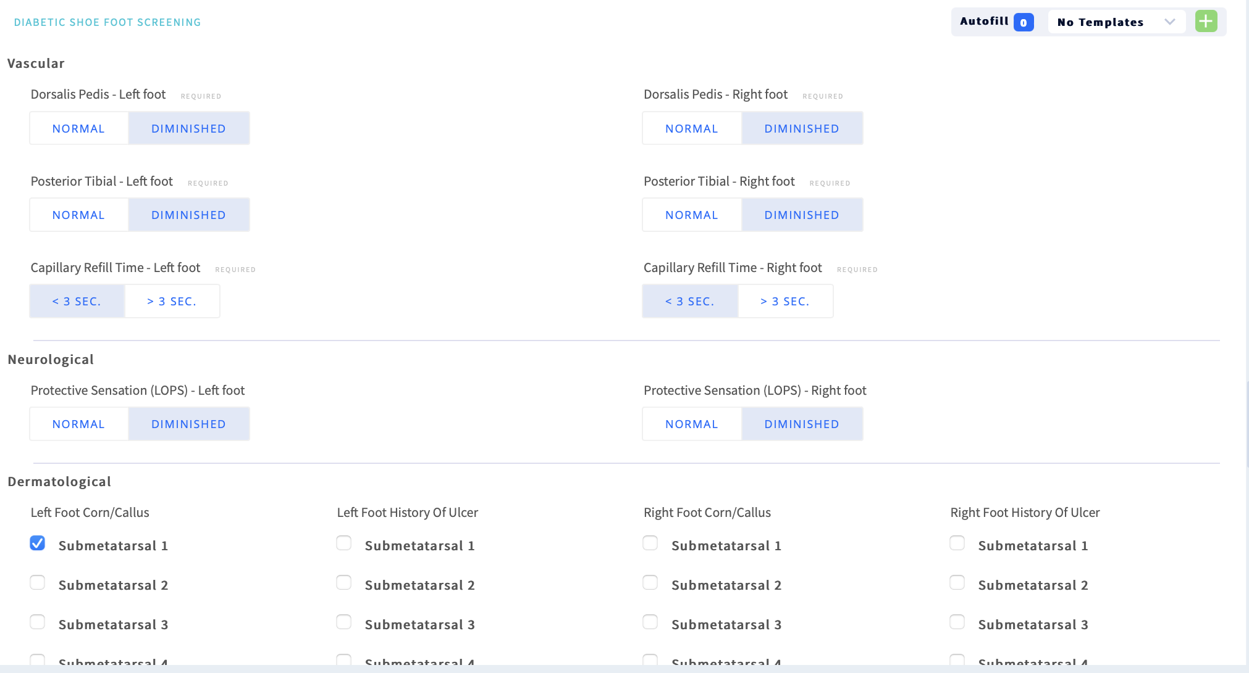
Diabetic Shoe – Foot Exam
Diabetic Shoe Foot Screening
Vascular
LOPS
Derm
MSK
Patient Info

Slide 19
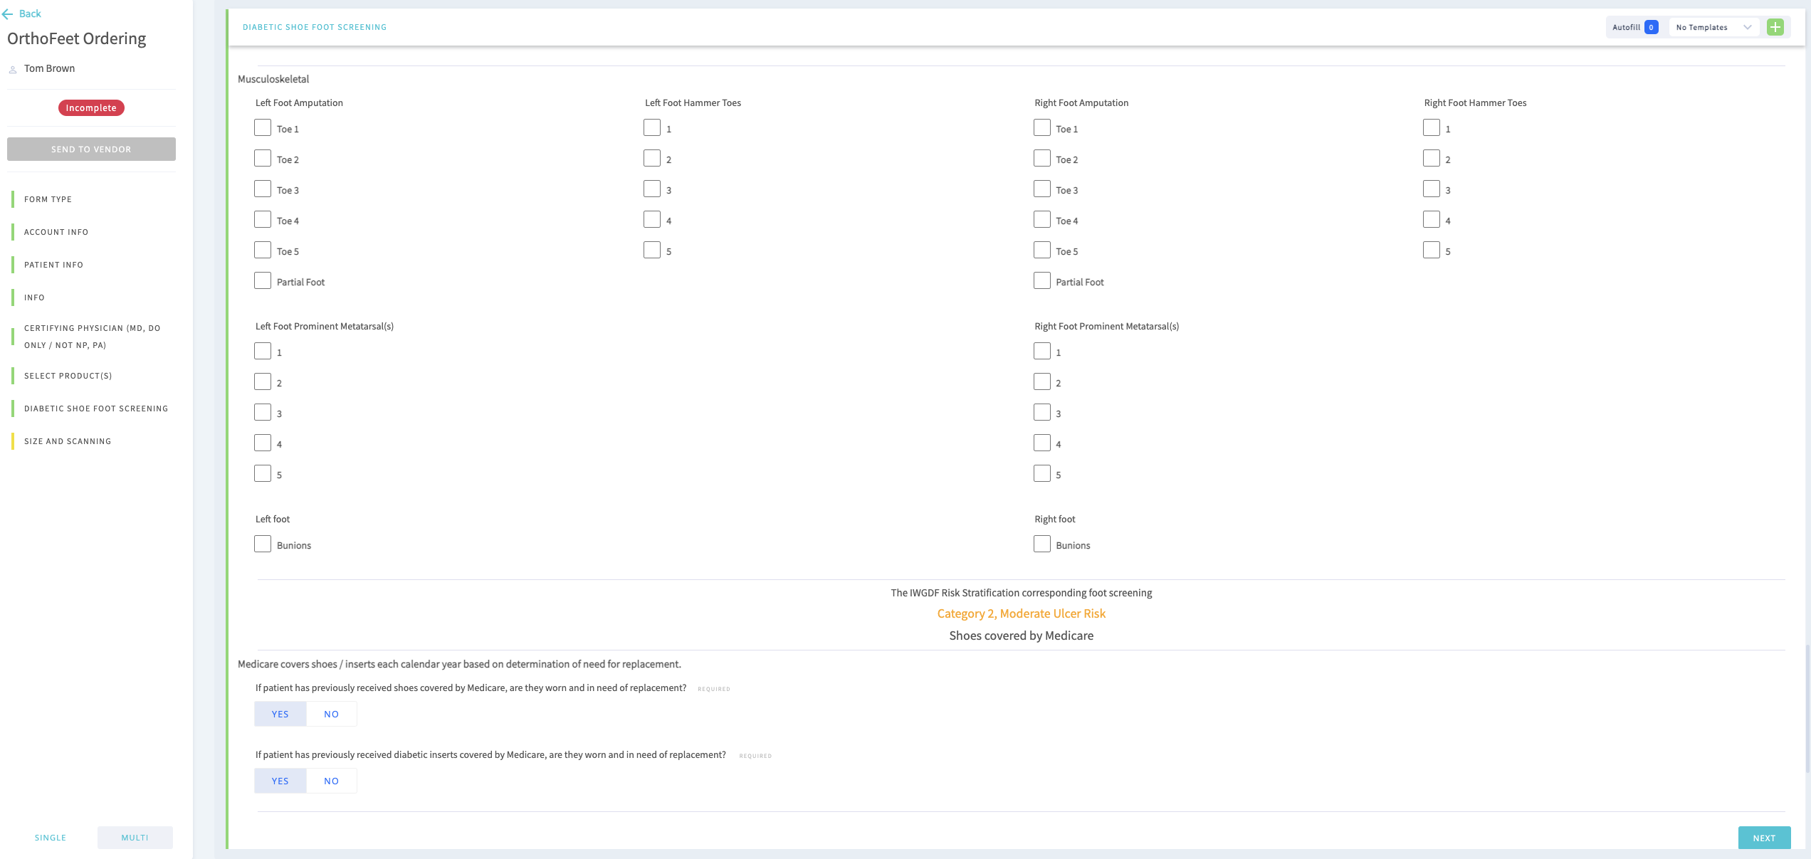
Diabetic Foot Shoe Screening “Procure EZ”
Diabetic Shoe Foot Screening
IWGDF Foot Risk Category
Replacement items
Foot measuring
Electronic signature, date
Send to vendor

Slide 20
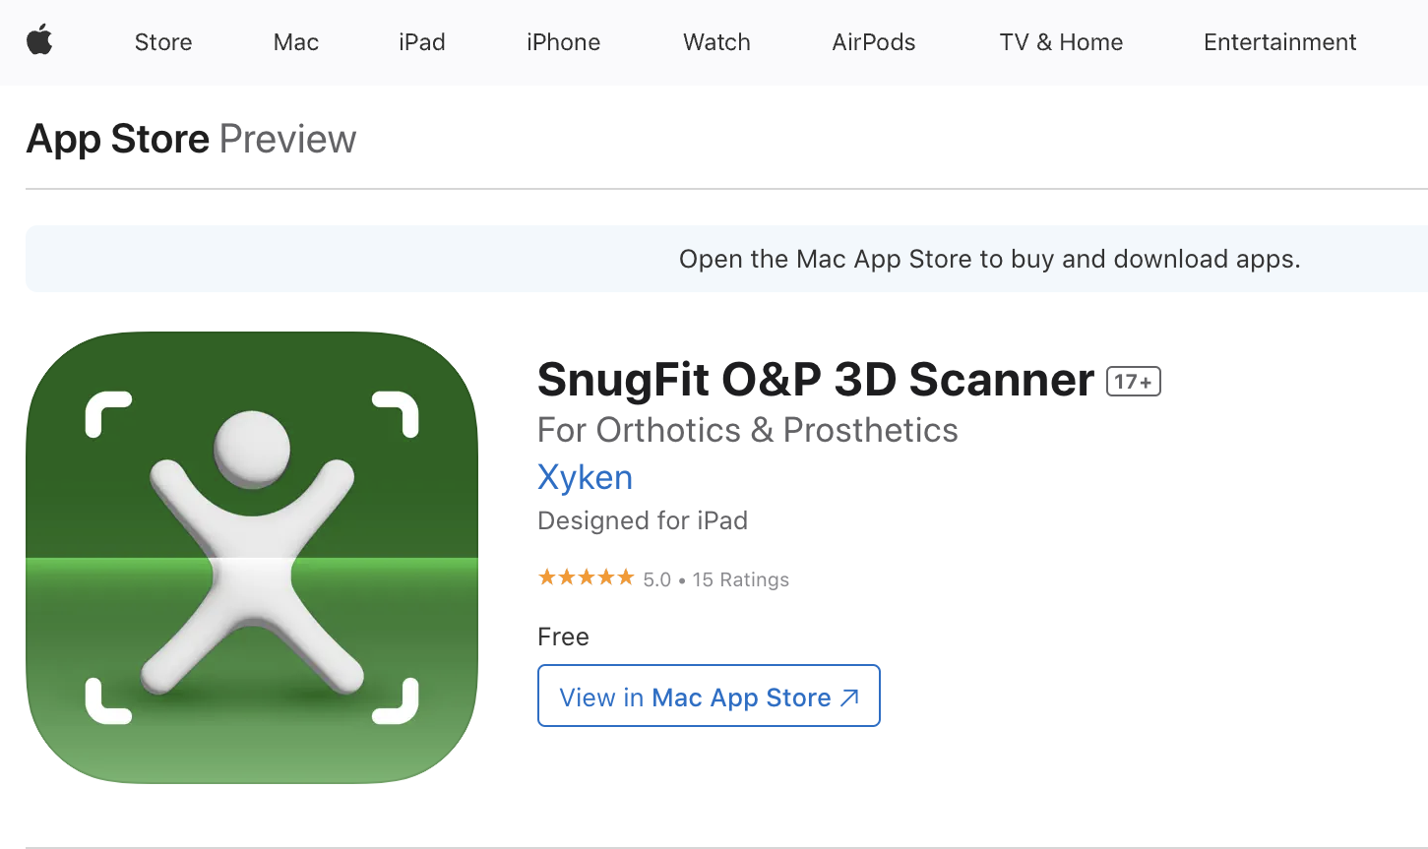
Size and Scanning
Foot measuring
“If the scanner doesn't work, please leave both attachment boxes empty and use 'SnugFit' app with the provided username and password. SnugFit on the app store: Click Here”
SEE THE SNUGFIT SCANNING TUTORIAL

Slide 21
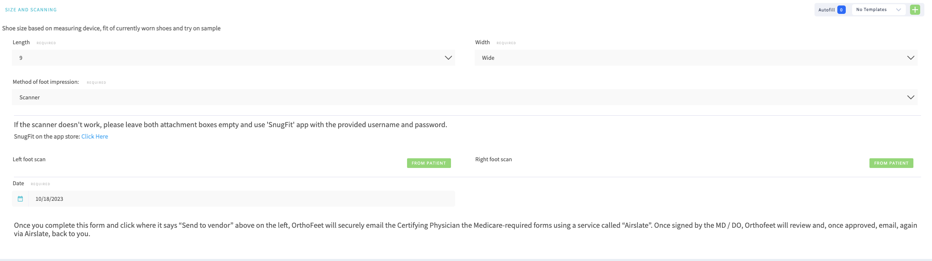
Size and Scanning
“Method of Foot Impression
Foam
Scanner
Plaster
Foot measuring
“If the scanner doesn't work, please leave both attachment boxes empty and use 'SnugFit' app with the provided username and password. SnugFit on the app store: Click Here”

Slide 22
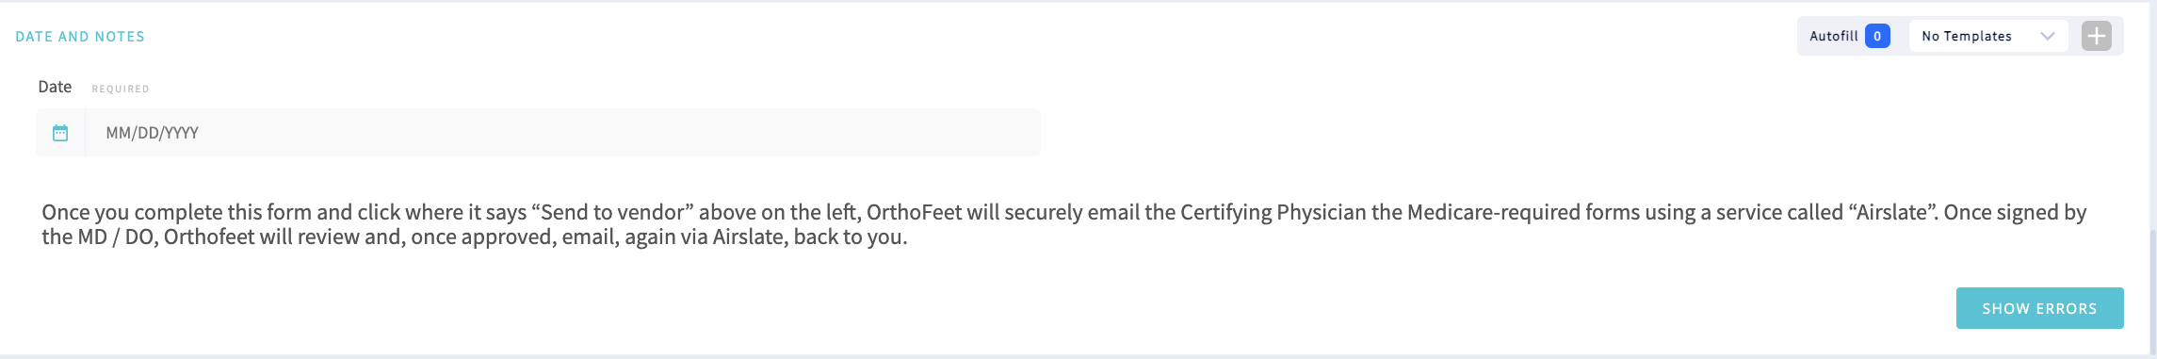
Date and Notes
“Method of Foot Impression
Foam
Scanner
Plaster

Slide 23
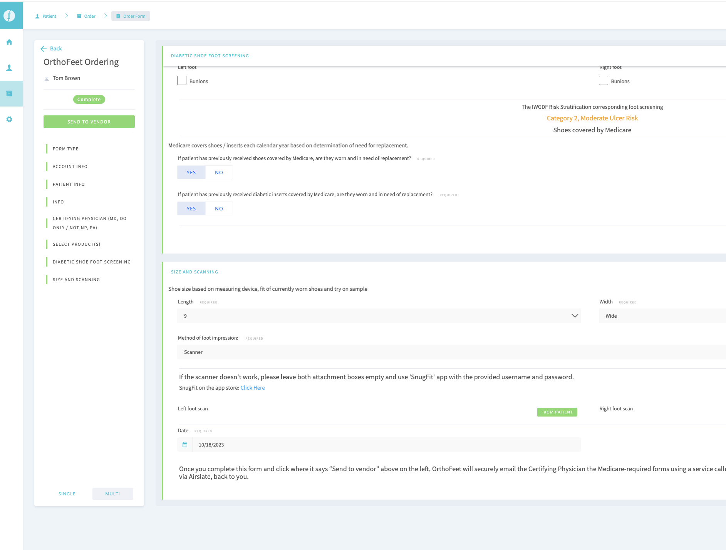
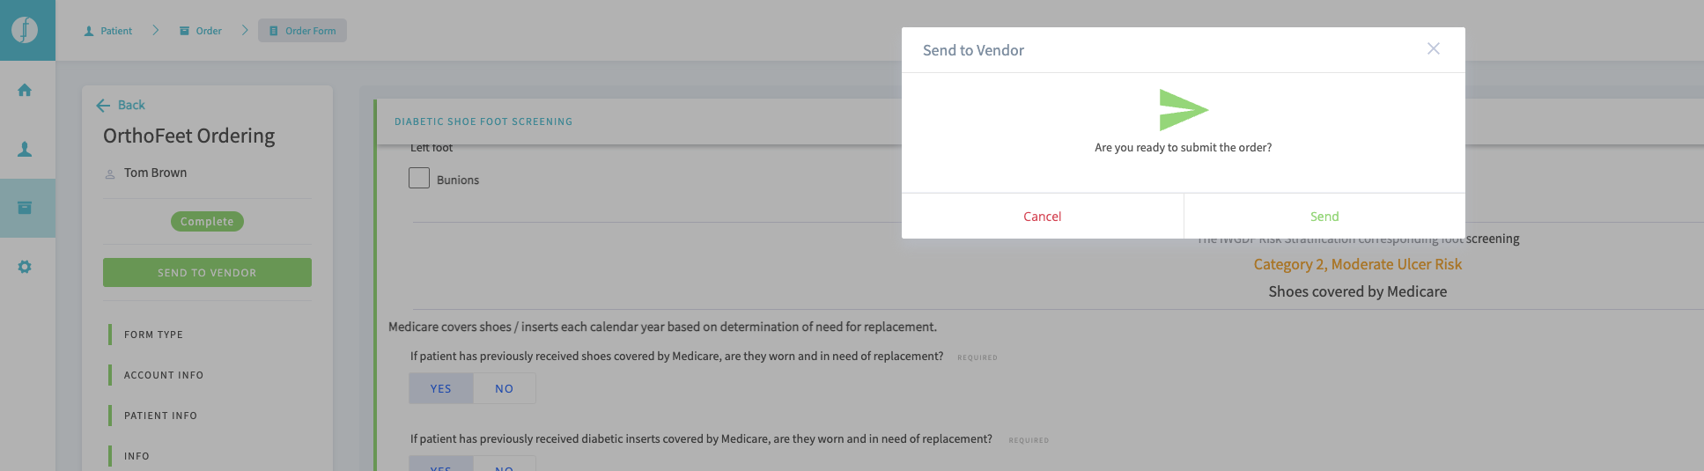
Size and Scanning, Send to Vendor
Send to vendor
Are you ready to submit the order?

Slide 24
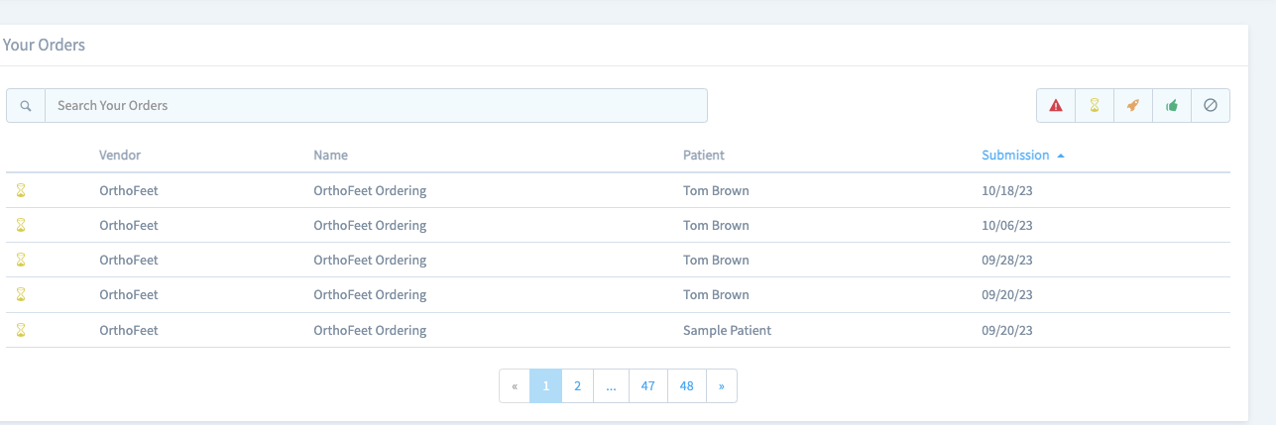
Your Orders

Slide 25
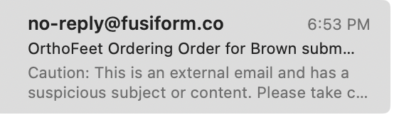
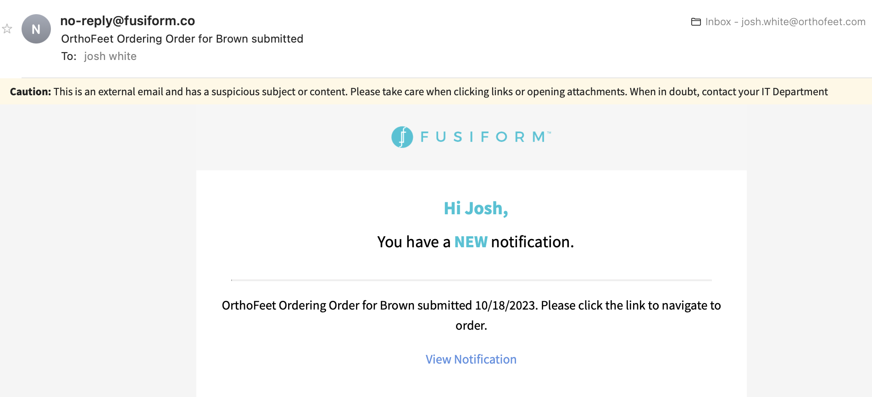
Step by Step How the process works:
Link to HIPAA secure portal emailed to Ordering Podiatrist

Slide 26
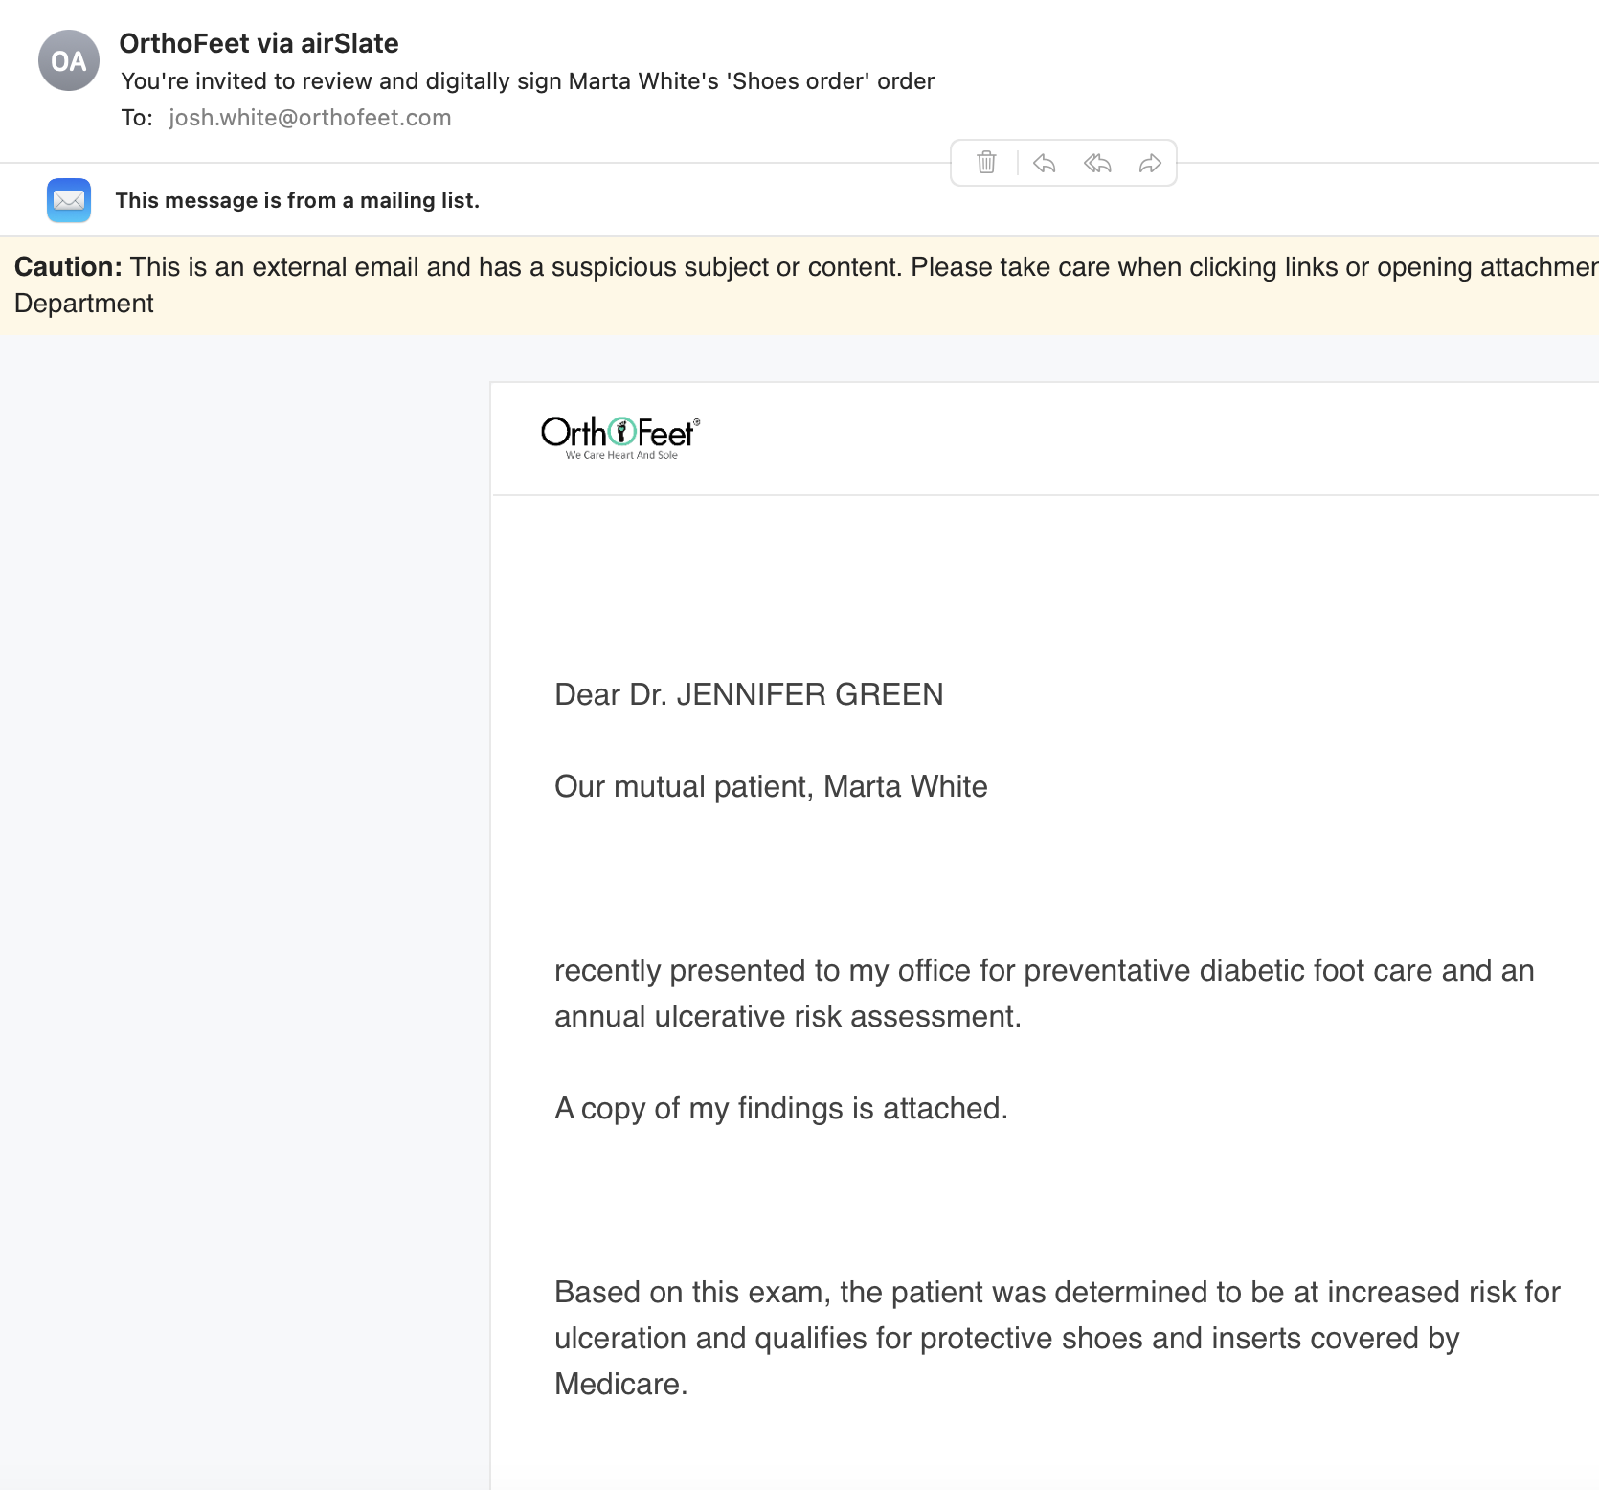
Step by Step How the process works:
Much easier for MD
HIPAA secure portal!
No printing!
No signing!
No faxing!
Link to HIPAA secure portal emailed to Certifying Physician
Certifying Statement
Relevant Medical Records (physician exam findings)

Slide 27
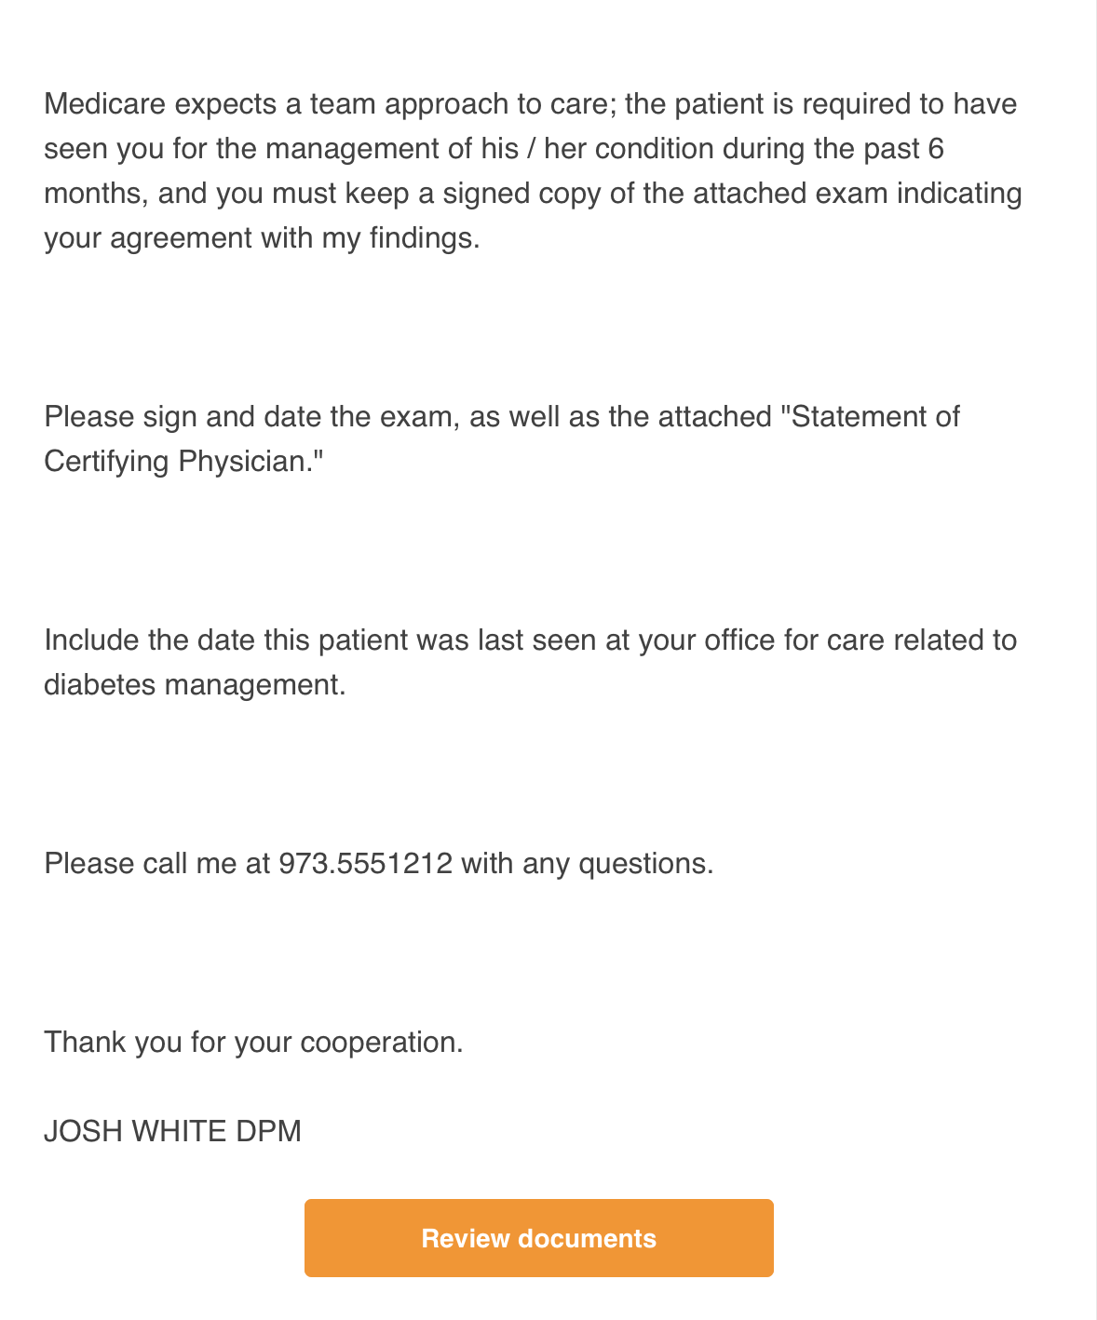
Step by Step How the process works:
Much easier for MD
HIPAA secure portal!
No printing!
No signing!
No faxing!
Link to HIPAA secure portal emailed to Certifying Physician
Certifying Statement
Relevant Medical Records (physician exam findings)

Slide 28
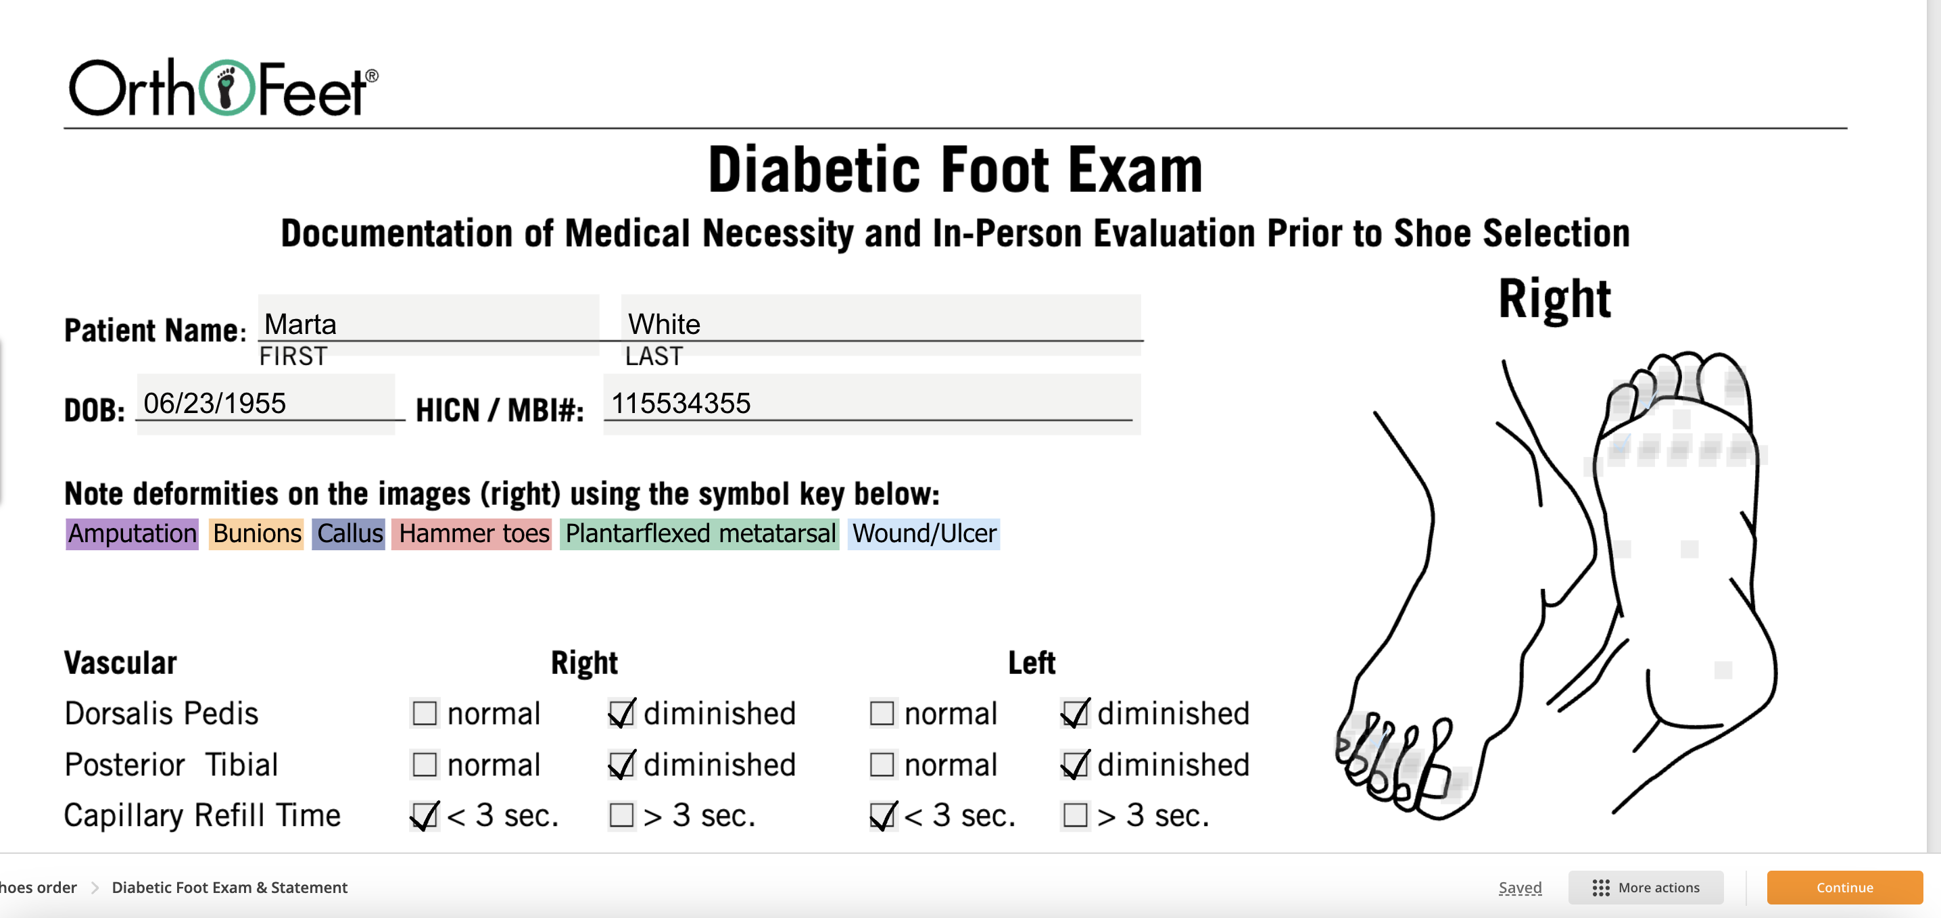
Step by Step How the process works:
Much easier for MD
HIPAA secure portal!
No printing!
No signing!
No faxing!
Link to HIPAA secure portal emailed to Certifying Physician
Relevant Medical Records (physician exam findings)
Certifying Statement

Slide 29
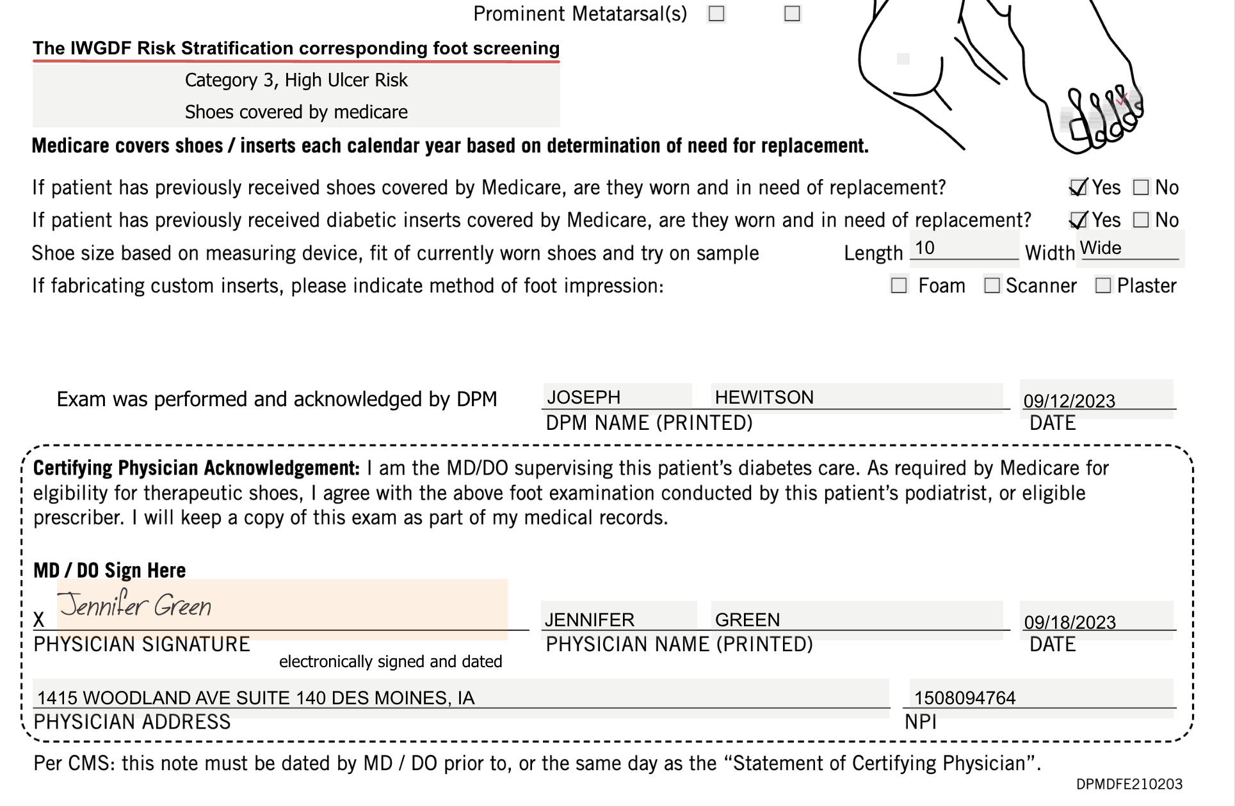
Step by Step How the process works:
Much easier for MD
HIPAA secure portal!
No printing!
No signing!
No faxing!
Includes: Attestation that MD DO agrees with findings by podiatrist and will keep a copy of this exam as part of their medical records.

Slide 30
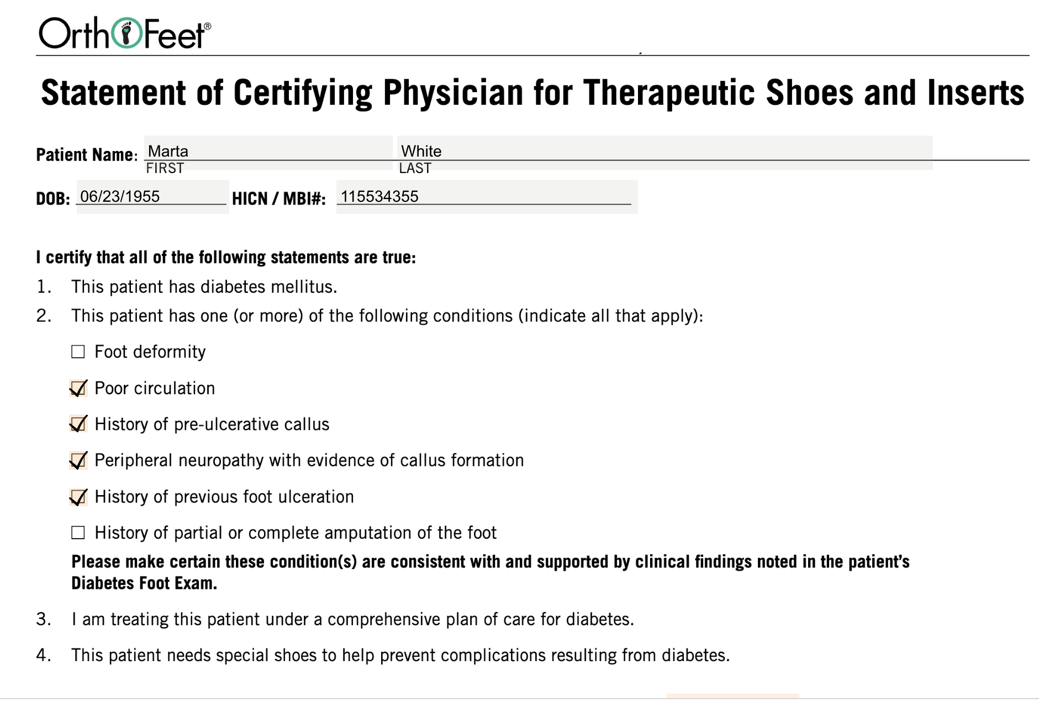
Step by Step How the process works:
Much easier for MD
HIPAA secure portal!
No printing!
No signing!
No faxing!

Slide 31
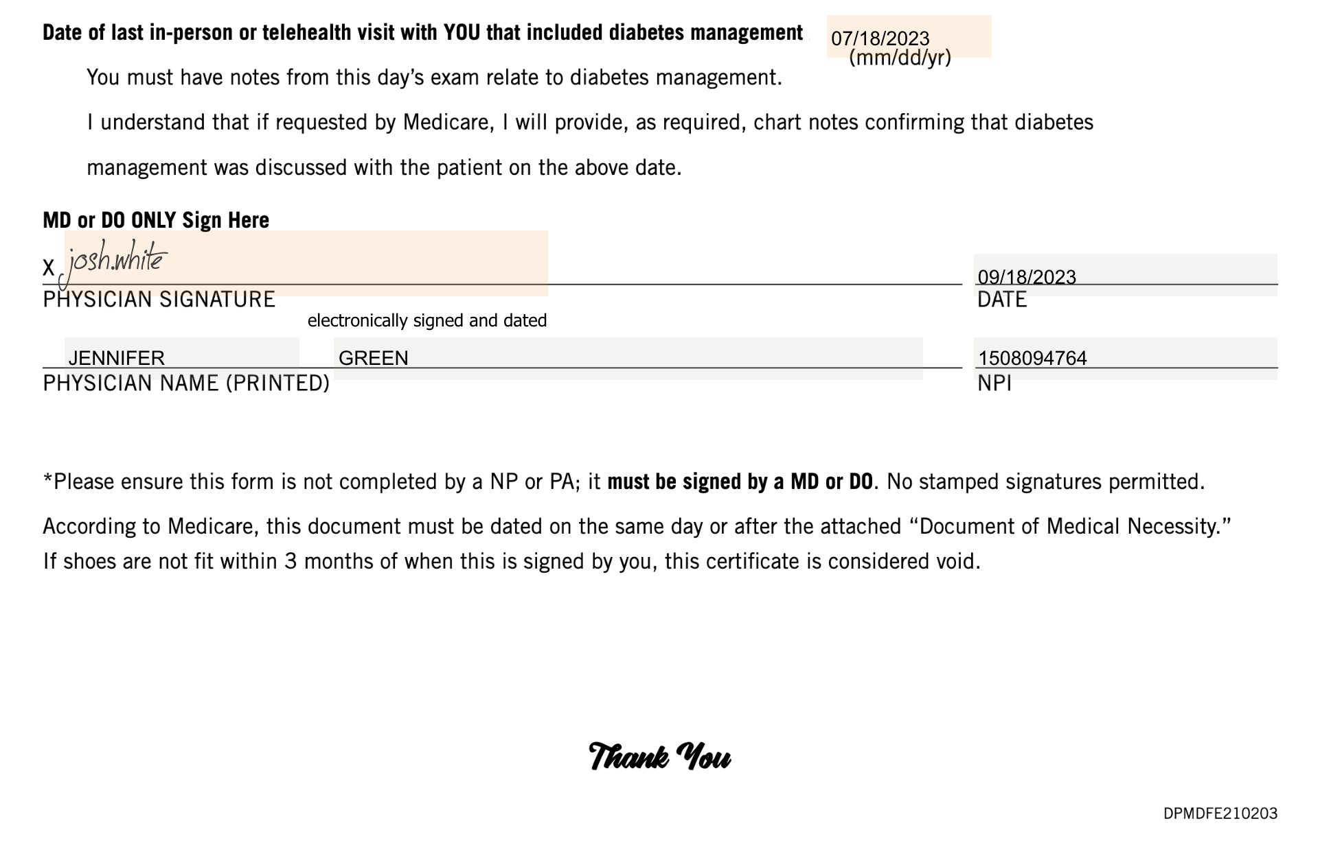
Step by Step Diabetic Foot Exam, Certifying Statement:
Only allow dates within 4 1/5 months
Includes: Date of last visit for diabetes management and allows electronic signature by certifying physician
Diabetic Foot Exam, Certifying Statement
Automatically emailed back to DPM once completed, electronically signed and dated.
Much easier for MD
HIPAA secure portal!
No printing!
No signing!
No faxing!

Slide 32
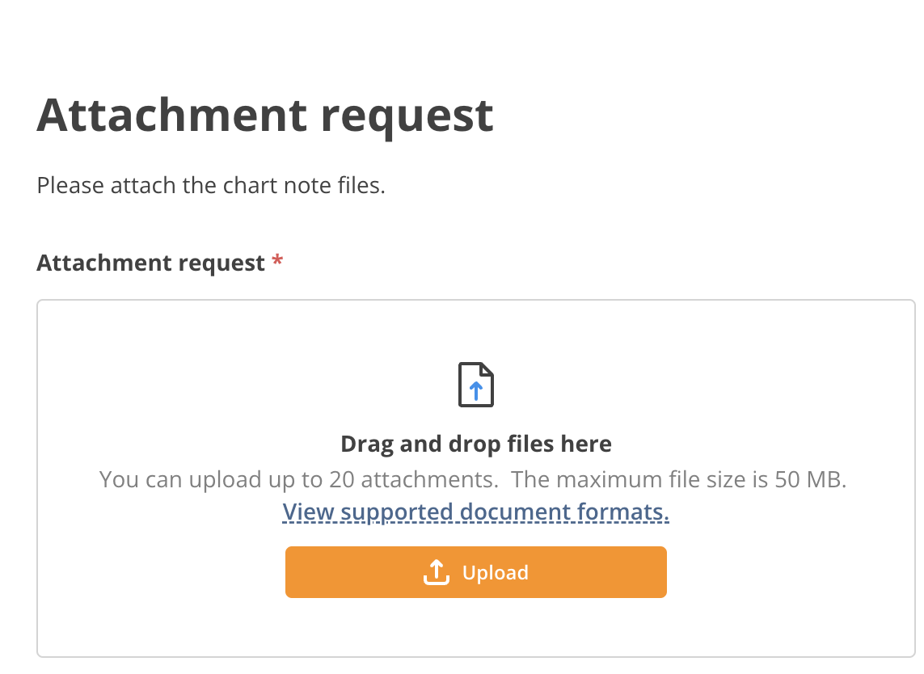
Step by Step How the process works:
Optional Request to MD to attach chart notes from diabetes management visit

Slide 33
Step by Step How the process works:
If MD not willing to share email address:
Enter DPM email in place of MD
Link to compliance docs sent to DPM
DPM to print docs and fax to MD
DPM to follow up with MD
Notifiy OrthoFeet when docs procured and approved.
Shoes / inserts shipped

Slide 34
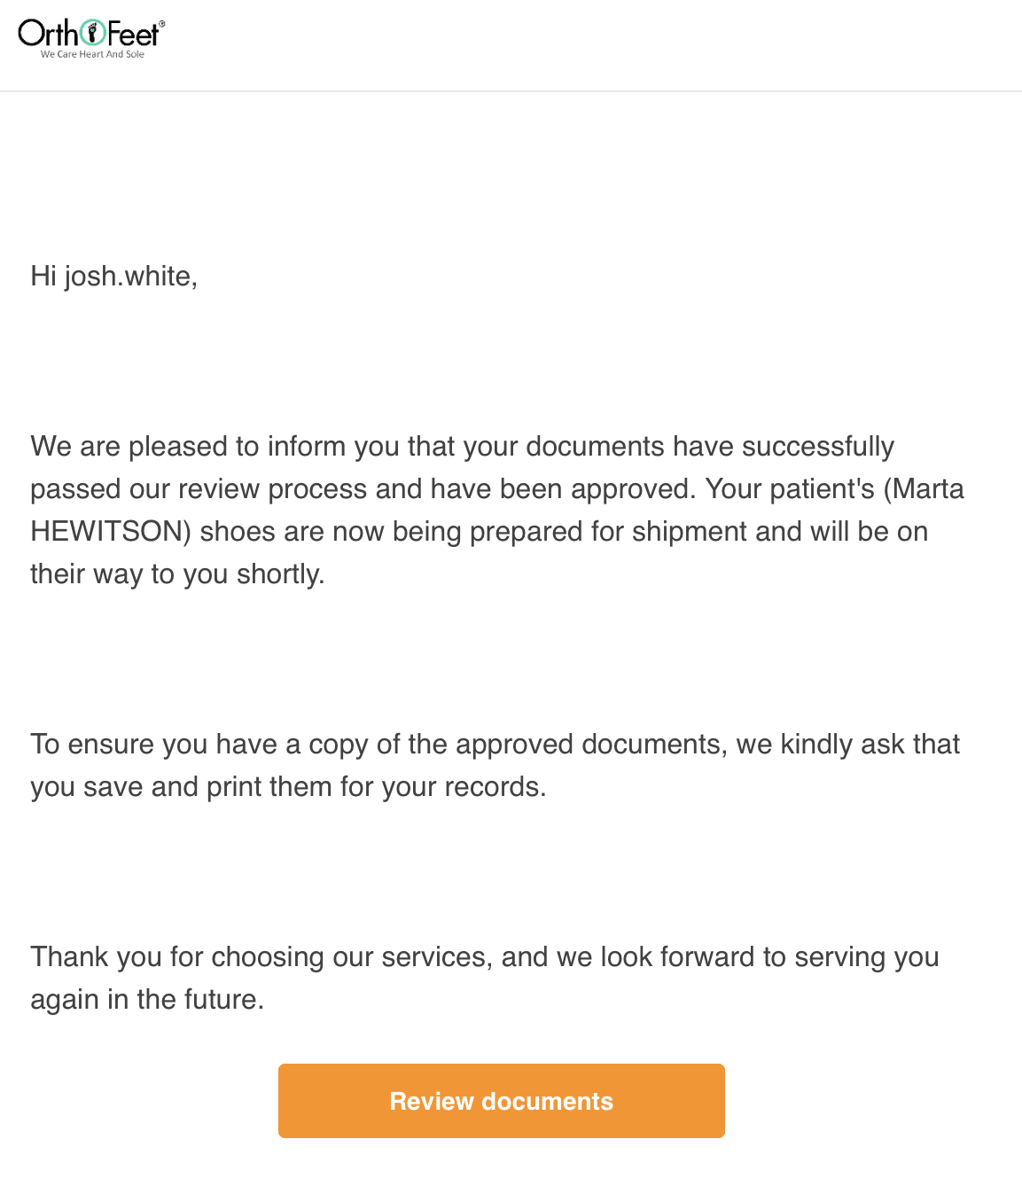
Step by Step How the process works:
Once compliance documents received from MD, link to HIPAA secure portal emailed to DPM / Supplier

Slide 35
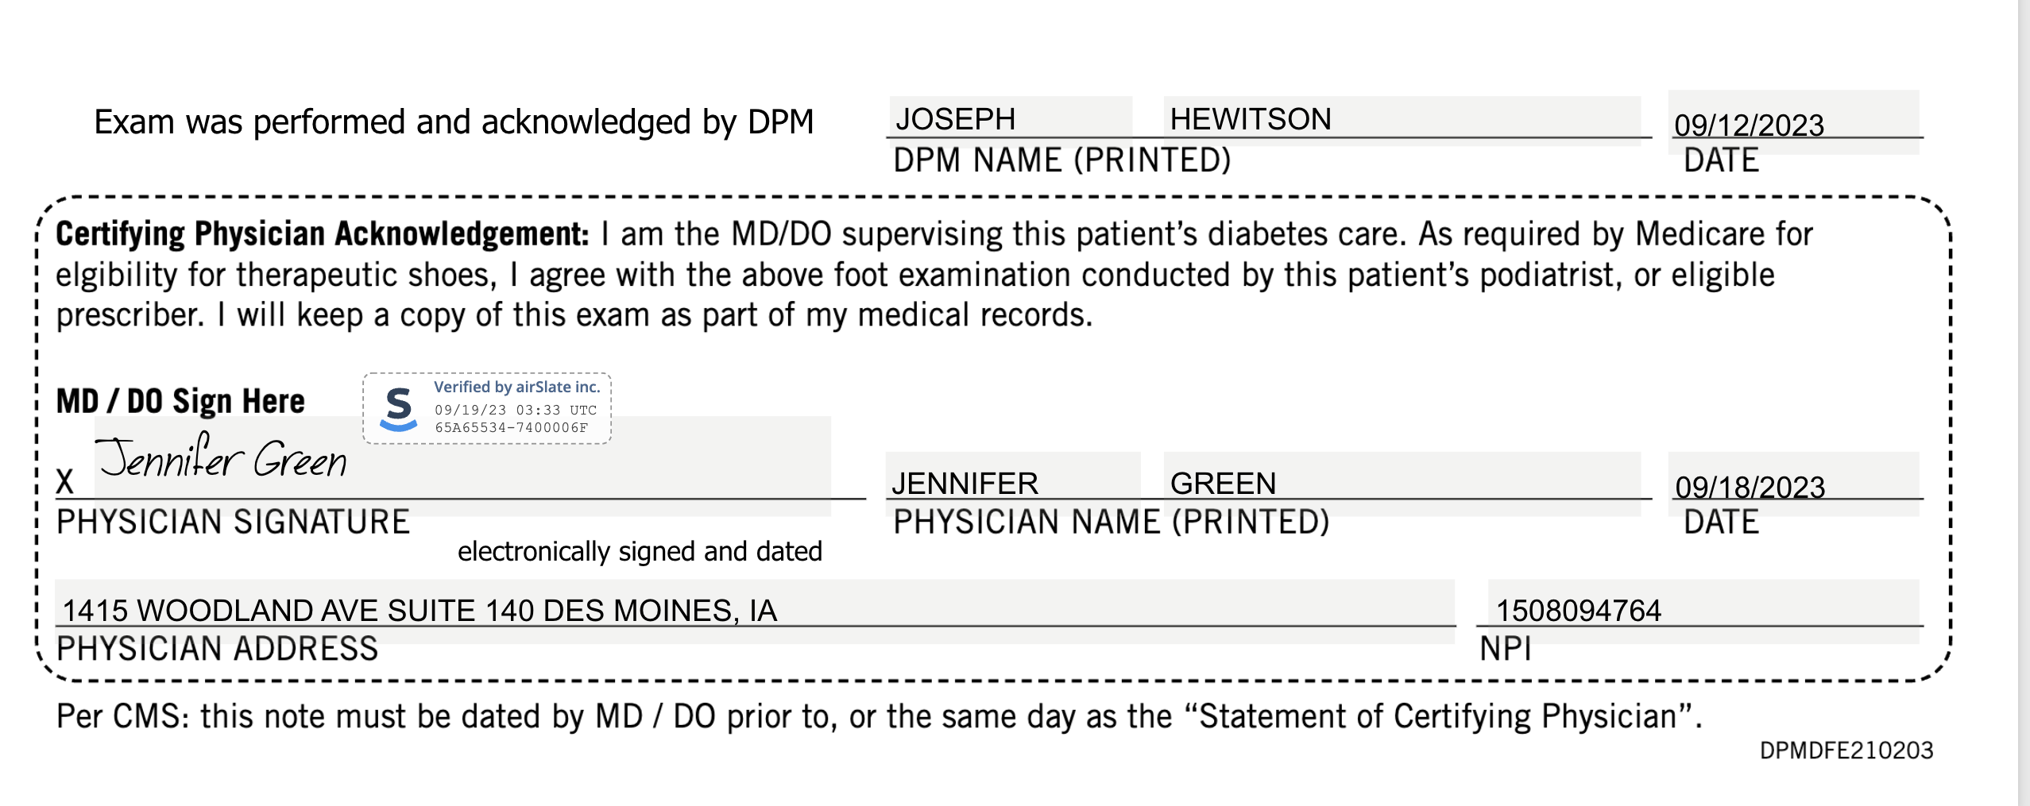
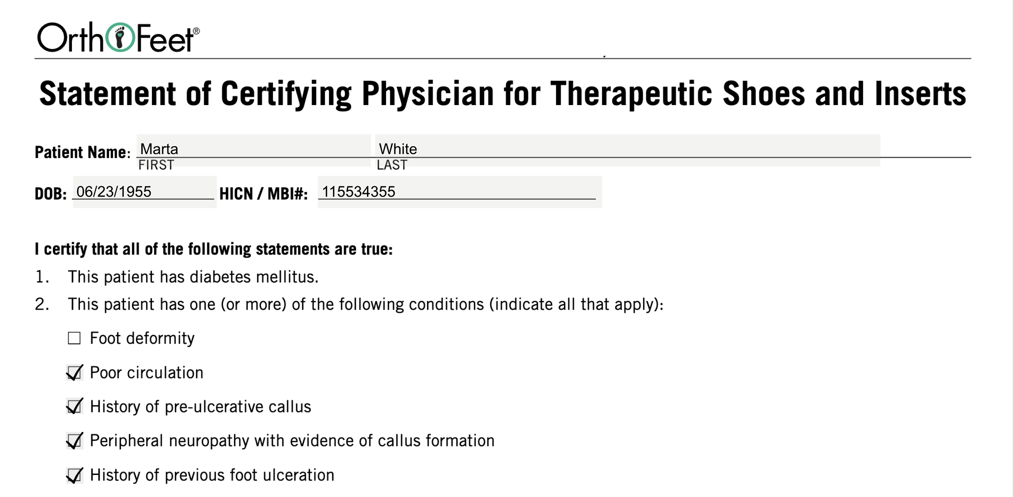
Step by Step How the process works:
Signed Foot Exam, Signed Certifying Statement

Slide 36
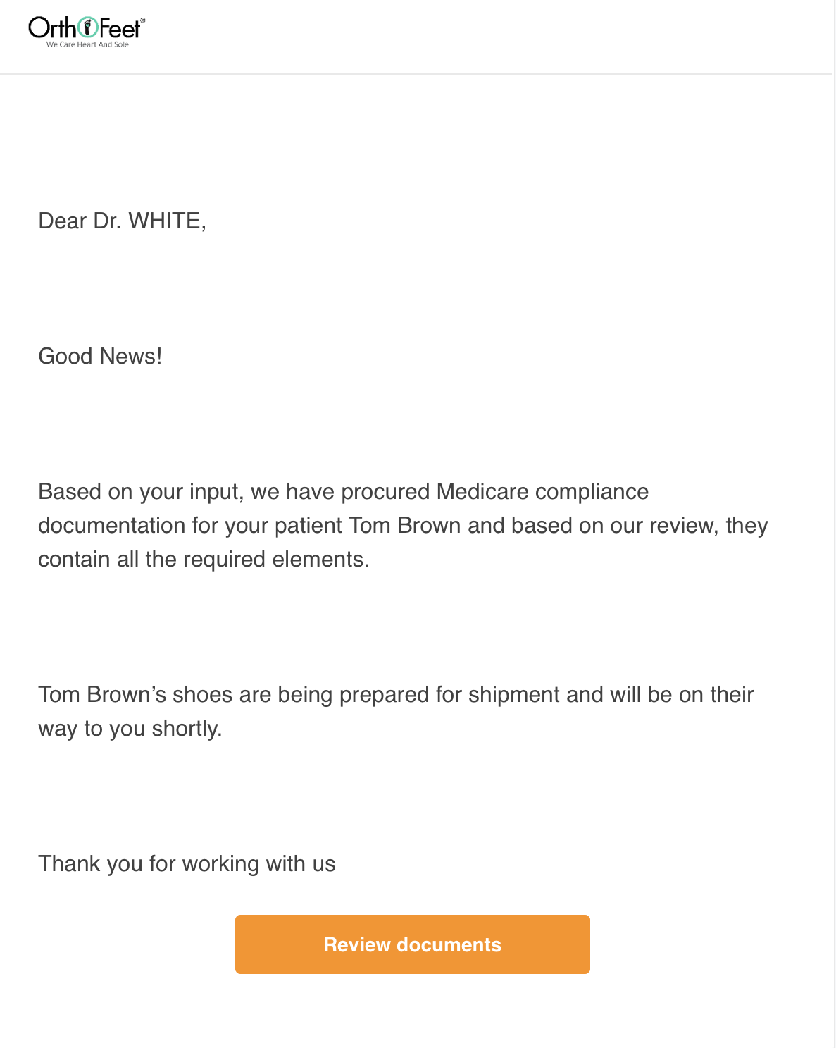
Last Link to HIPPA secure portal emailed back to DPM
Contains:
Diabetic Foot Exam, signed by MD
Statement of Certifying Physician, signed by MD
MD chart notes (if attached)

Slide 37
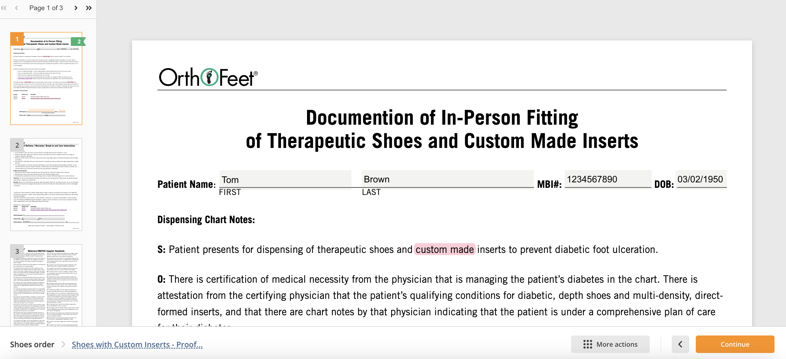
Also contains Dispensing Visit forms
DMEPOS Supplier Standards
Proof of Delivery / Certificate of Receipt
Documentation of In-person Fitting

Slide 38
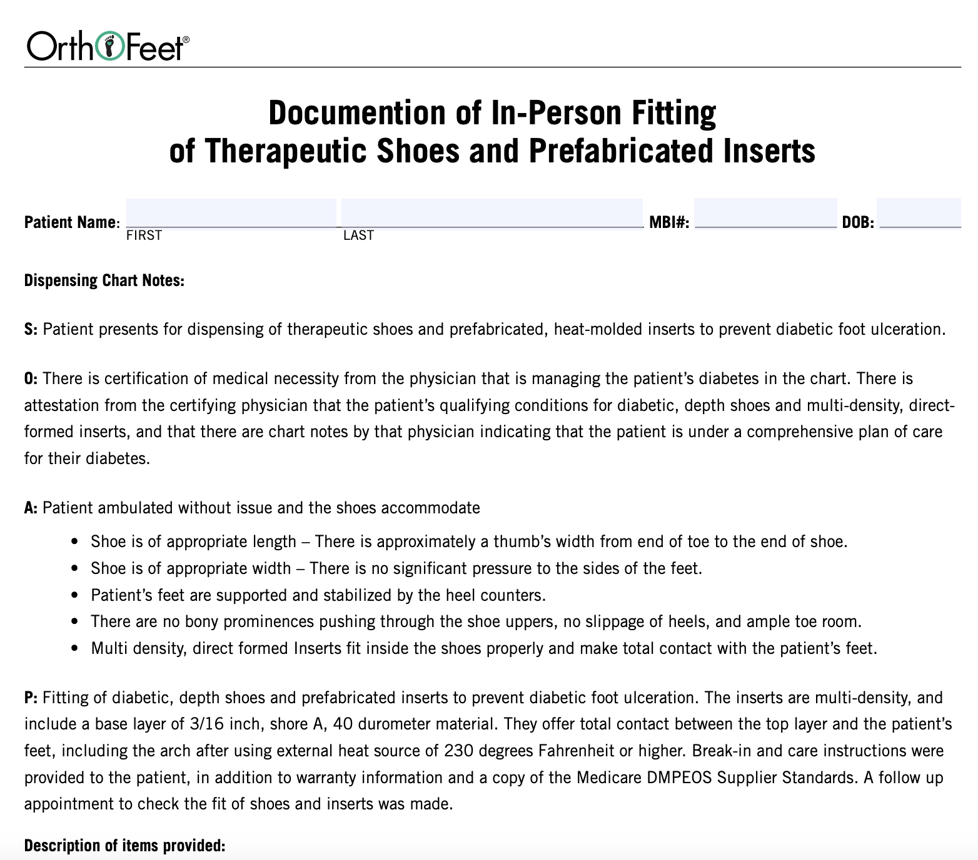
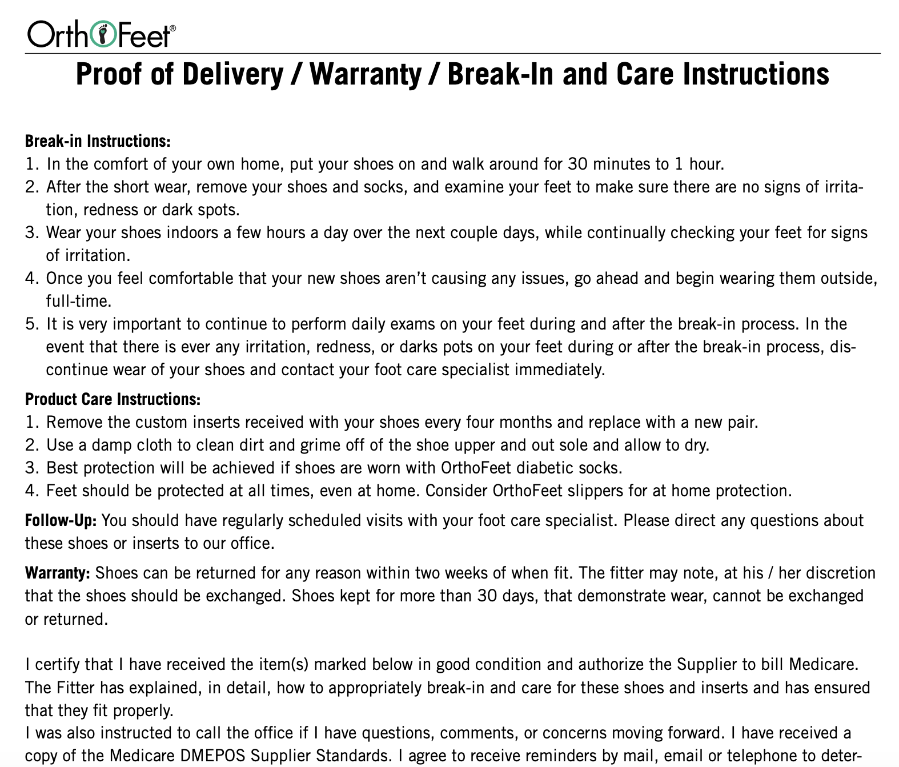
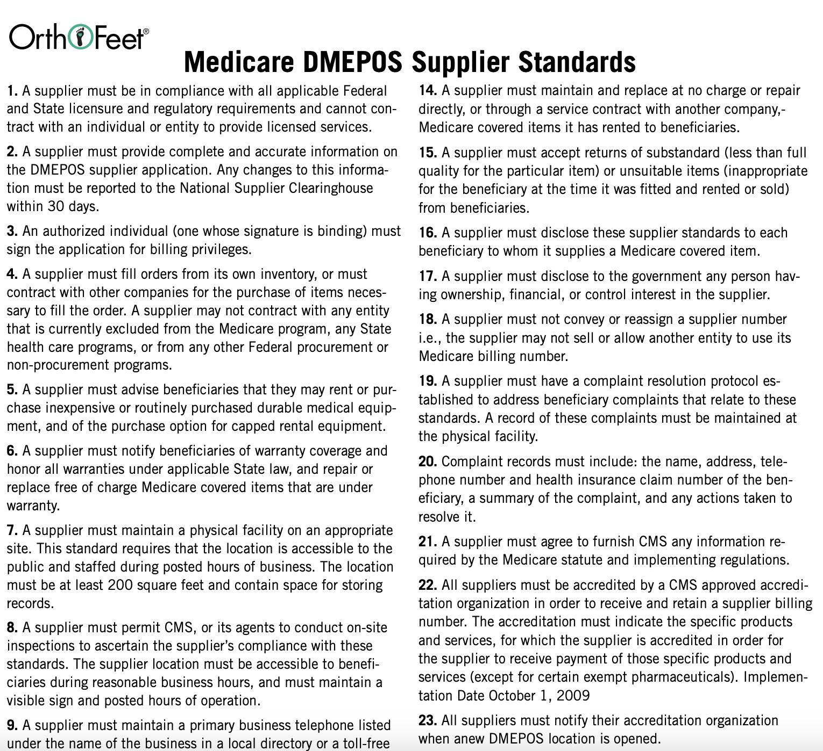
Dispensing Visit:
Proof of Delivery / Certificate of Receipt
Documentation of In-person Fitting
DMEPOS Supplier Standards

Slide 39
Roles and Responsibilities
Front Office / Scheduling
Identifies patients with diabetes to ensure that they are provided an annual diabetic foot exam.
Podiatrist
Performs Diabetic Foot Exam
Prescribes shoes when qualifying risk factors present.
Supervises shoe selecting / dispensing
Shoe Selecting / Shoe Dispensing :
Selects the best shoes that are therapeutically appropriate and aesthetically acceptable.
Reiterates DPM’s message about shoes’ importance
Compliance / Prior Authorization
Ensures procurement of MD compliance documentation
Confirms prior authorization if Medicare Advantage
Responds to audits

Slide 40
Summary
Medicare has clearly provided information about documentation requirements
A solution exists such that DPM suppliers can confidently participate in the Medicare Therapeutic Shoe program...It’s OrthoFeet Compliance Check!

Slide 41

Thank you
Notes:
Thank you!

